Slide 1
UTT LIBRARIES CATALOGUE
Access and Use

Slide 2
What is a Library Catalogue?
A structured database containing records for items owned by one library, or a network of libraries at several locations.
It is like the search engine of the library.
Think of it as your treasure map 🗺️
It includes:
  Books (print & e-books)
  Journals (print & electronic)
  Articles
  Multimedia (DVDs, maps, etc.)
  Other resources.

Slide 3
Use the Library Catalogue to:
Identify and locate material on the library shelves by keyword, author, title, subject, etc.
Determine the availability of items in the library
Obtain information on items
Cite an item
Sign In to your EbscoHost Account to access your Folder

Slide 4
Search Tips for Using the Library Catalogue:
  1. Use a keyword search when:
You are beginning your research
You are searching for a new trend or concept
You are not sure of the correct subject heading
The database does not have subject headings
You are looking for specific factual information
  2. Use an author, subject, or title search when the author, subject or title are known

Slide 5
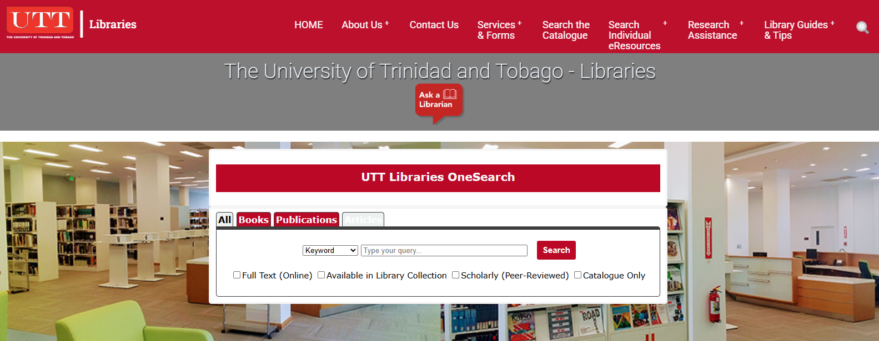
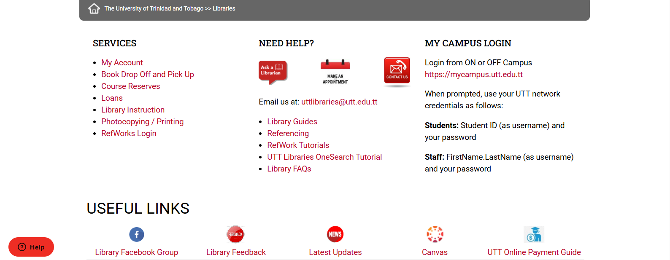
Access UTT Libraries Website via Direct Link
Link to Library’s Website @ https://u.tt/library

Slide 6
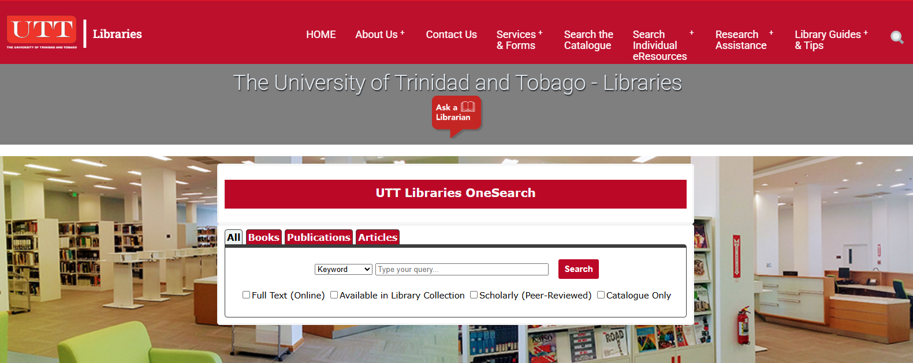
Access the Library Catalogue:
1. From the main menu (red) bar, click on Search the Catalogue
OR
2. From the UTT OneSearch box, select Catalogue Only, enter your search term in the search box and click Search

Slide 7
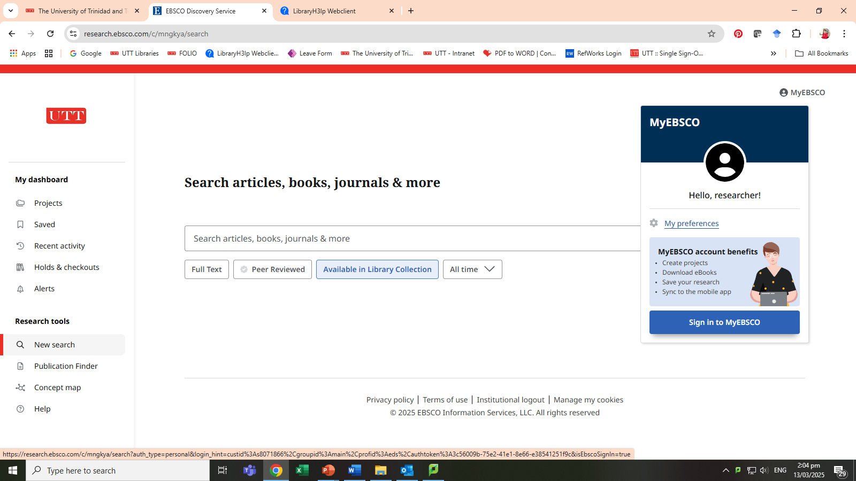
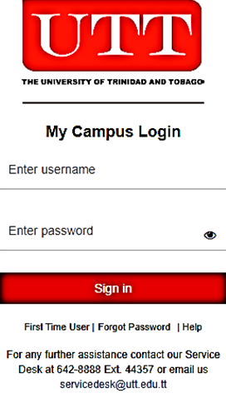
Sign In:
1.Click on MyEBSCO
2. Click on Sign In to MyEBSCO and sign in via My Campus Login

Slide 8
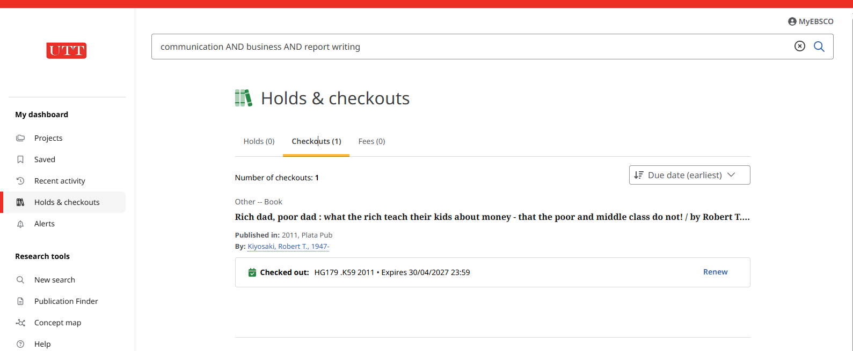
Use “My Account” to:
See items checked out:
Items Date Due
Renew items if renewable
Fines owed
Check Hold status on items requested
My “EbscoHost” Account:

Slide 9
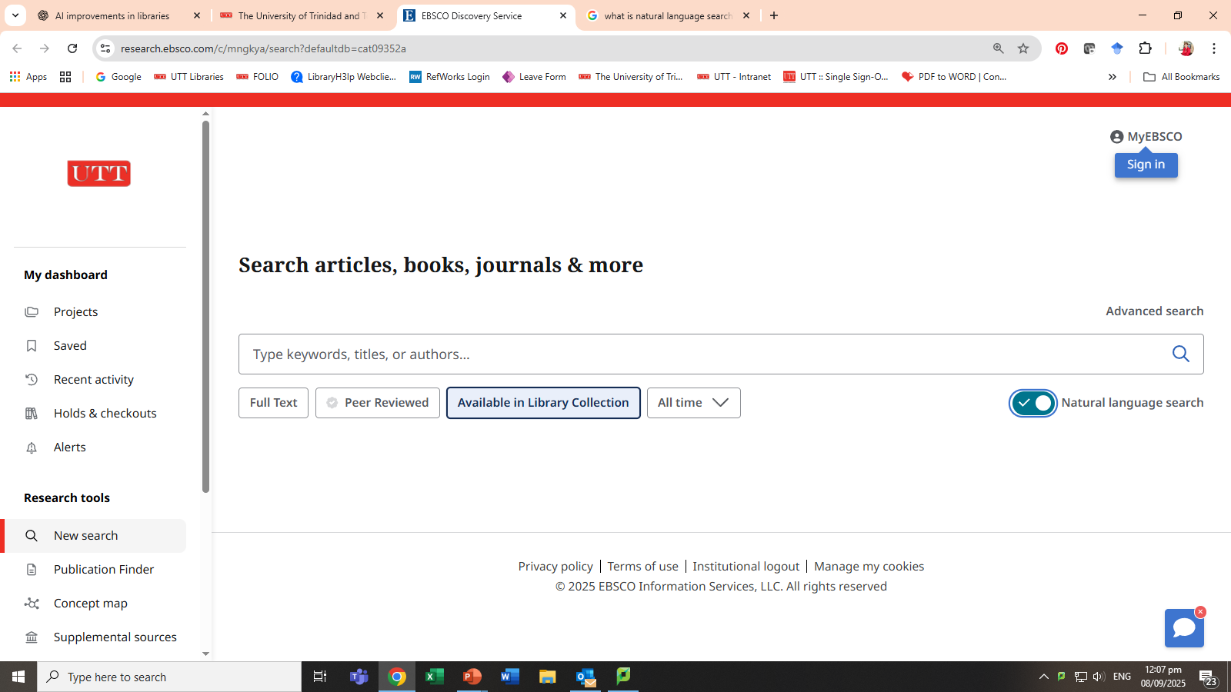
Search the Library Catalogue:
Basic Search:
Enter your search term in the search box, select Available in Library Collection
and click Search. Option to use Natural Language now available.
Click on link to Chat with library staff

Slide 10
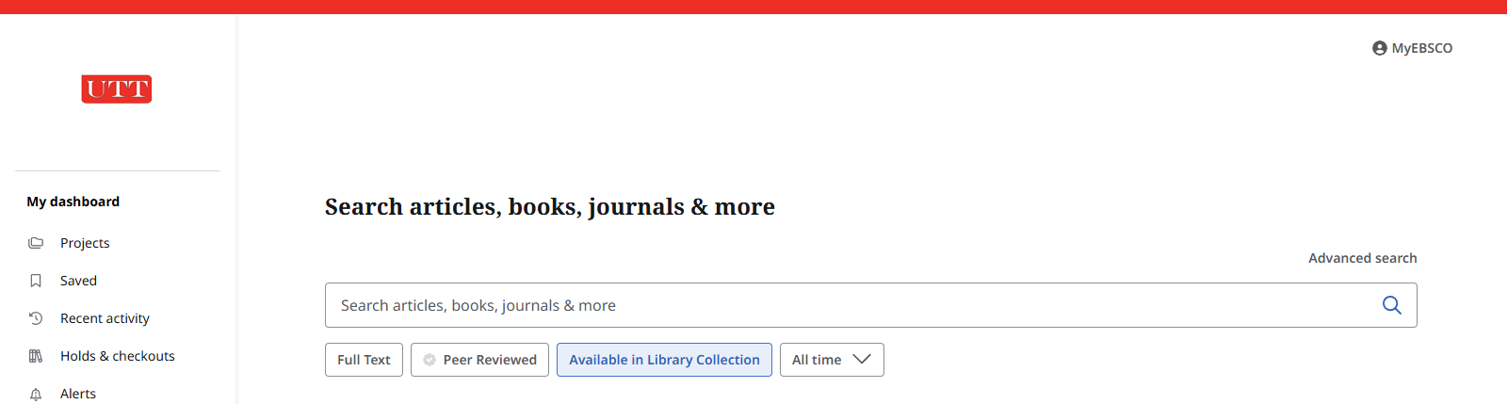
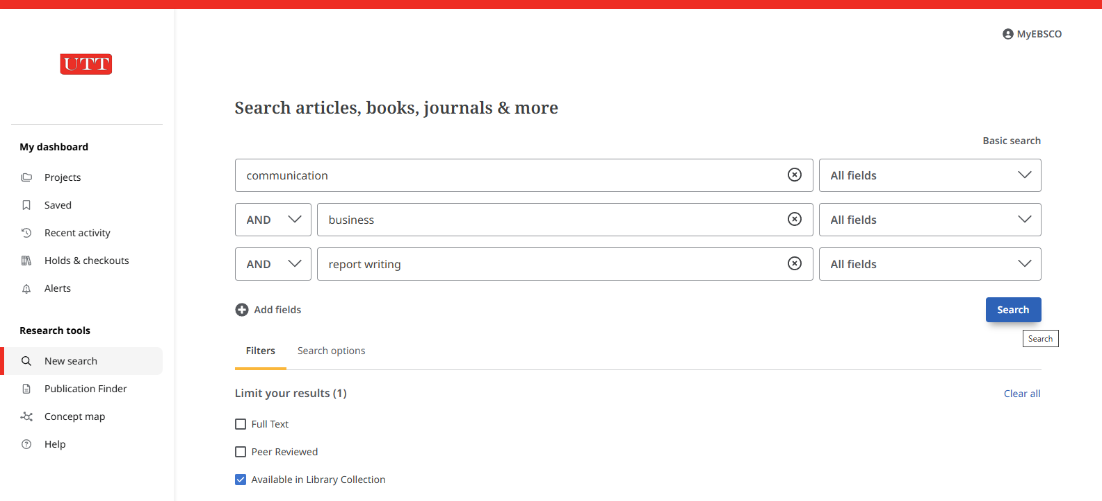
Search the Library Catalogue:
Advanced Search:
1. Click on Advanced search
2. Type your search terms in the search boxes. Optional: Select Filters to narrow search

Slide 11
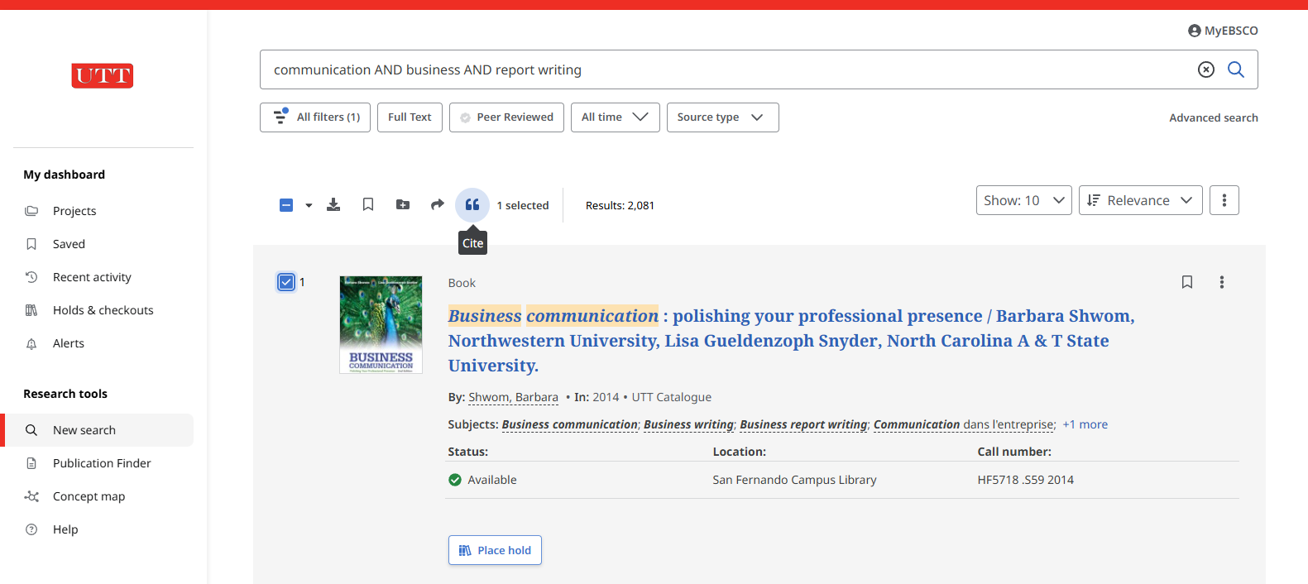
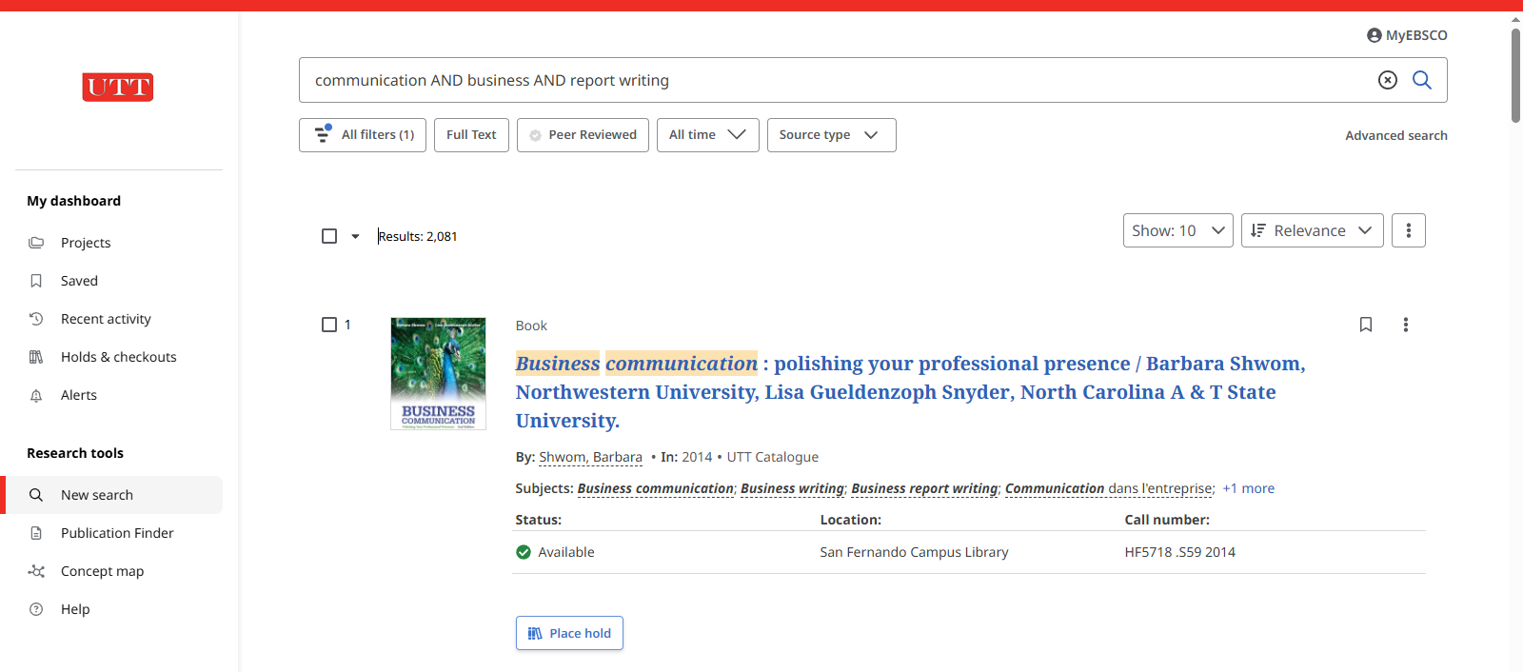
The Search Results Page:
Filters to narrow search
Filters to narrow search by:
Relevance: Date Newest/Oldest
Show # hits on page:
Tools
Results
Save Search
Create Alert
Item Details
Call Number:
A combination of letters and numbers that is used to find where a book is located on the library shelves
Campus Library at which the item is available
Item Status
Option to Place Hold

Slide 12
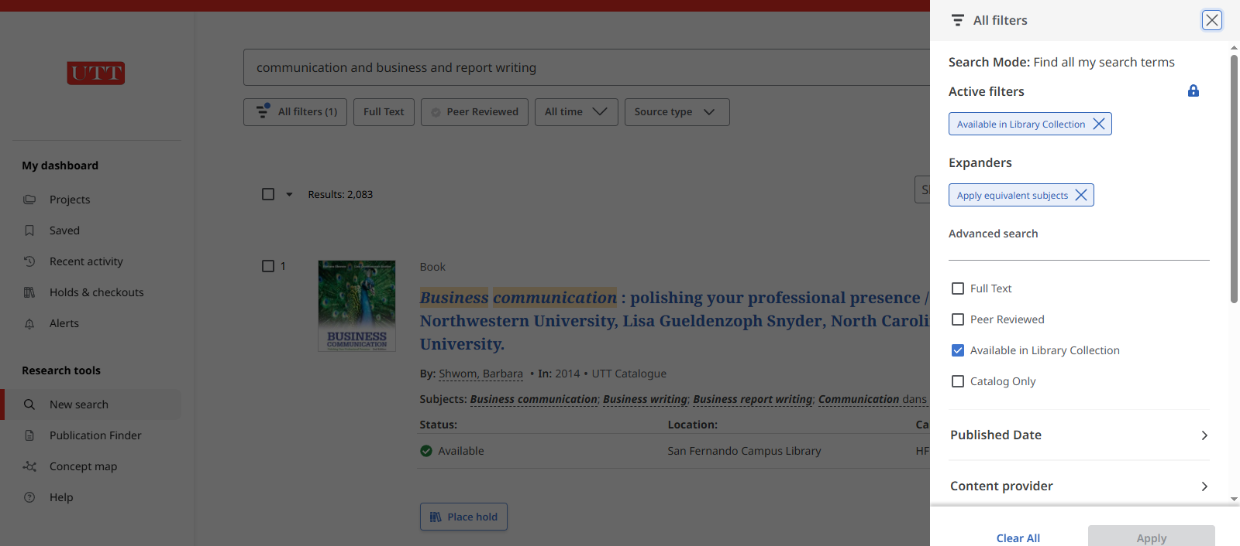
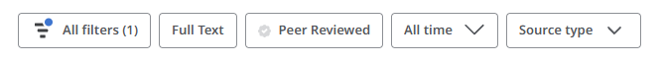
Interpreting the Search Results Page:
Filters
Use Filters to narrow your search

Slide 13



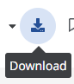
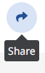

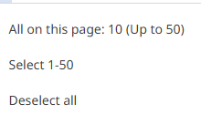

Interpreting the Search Results Page:
Tools
Tools
Use to locate publications in your institution’s collection
Use to explore connections between elements of a topic

Slide 14
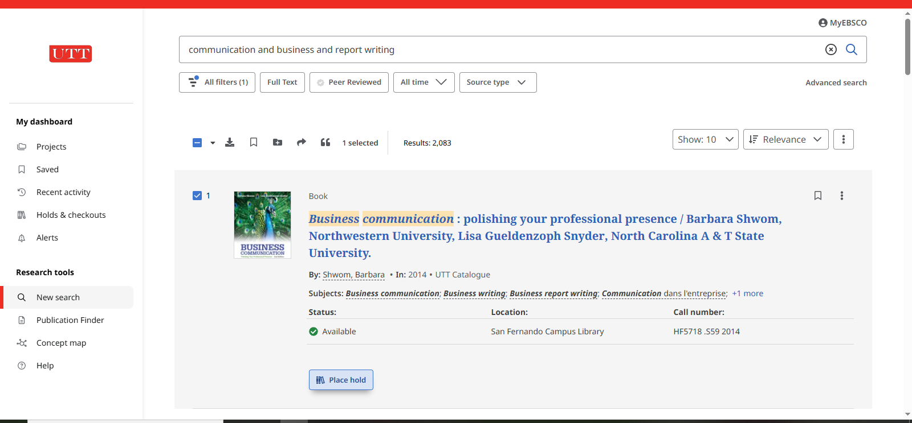
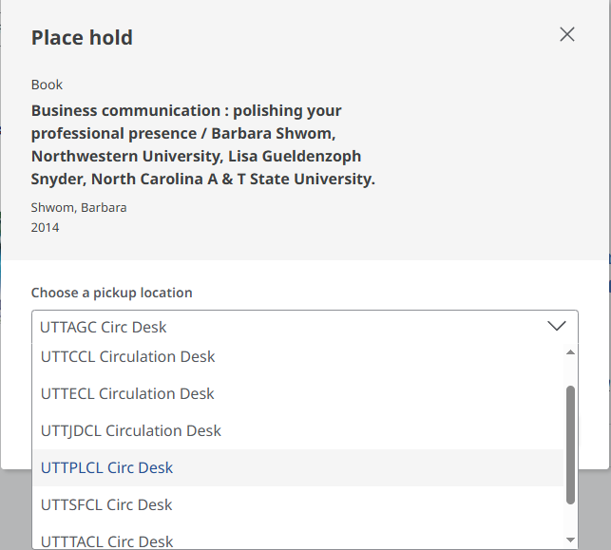
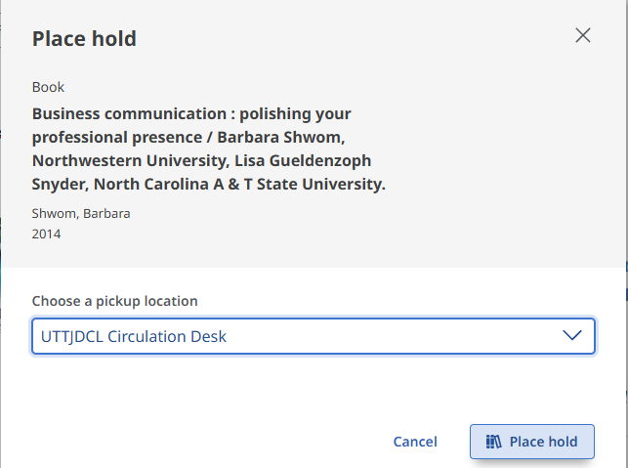
Place a Hold on an item:

Slide 15
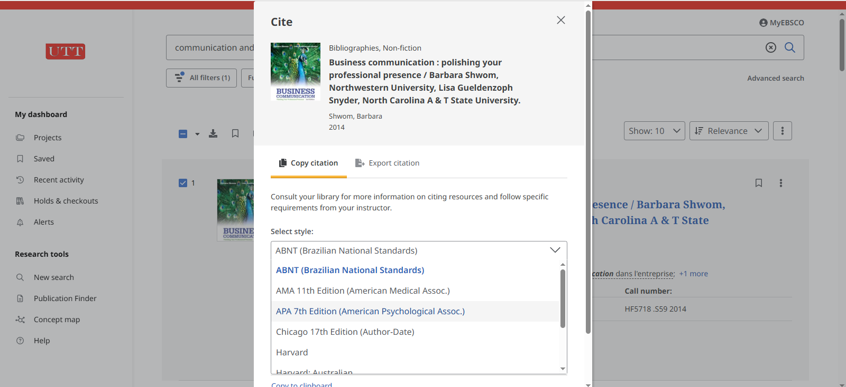
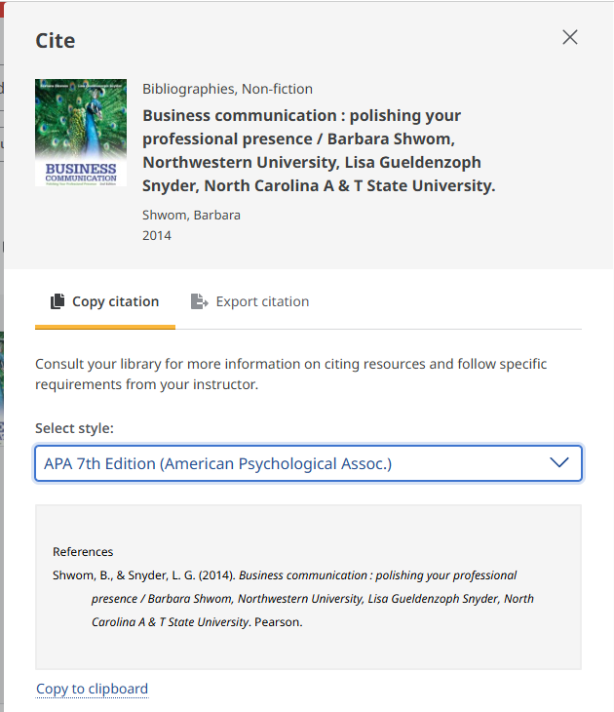
Cite an Item:
Step 3:
Copy citation and paste in the References list in your assignment
Ensure that the structure (e.g. punctuation & spelling) is correct
Step 1:
Click on Cite to get References
Step 2:
Select required style, e.g. APA 7th edition

Slide 16
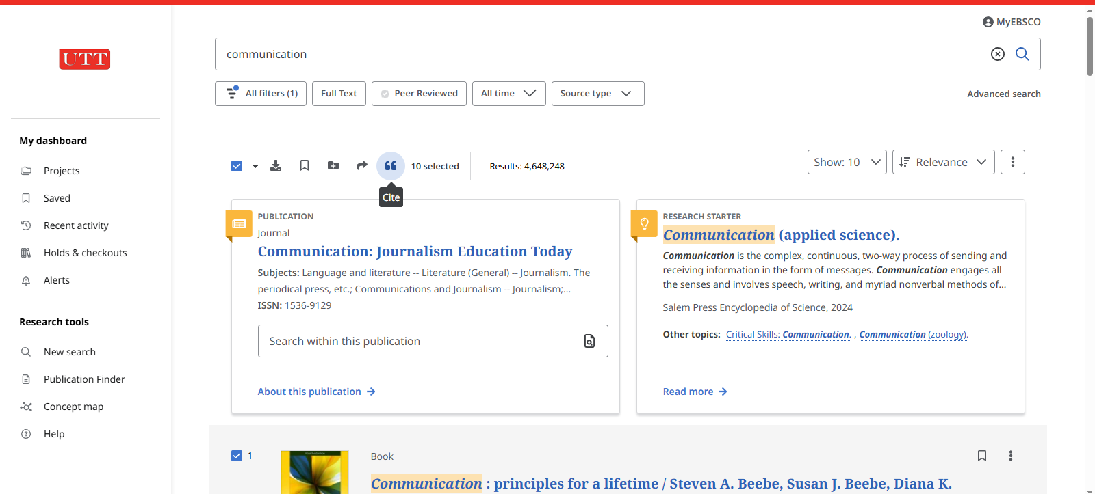
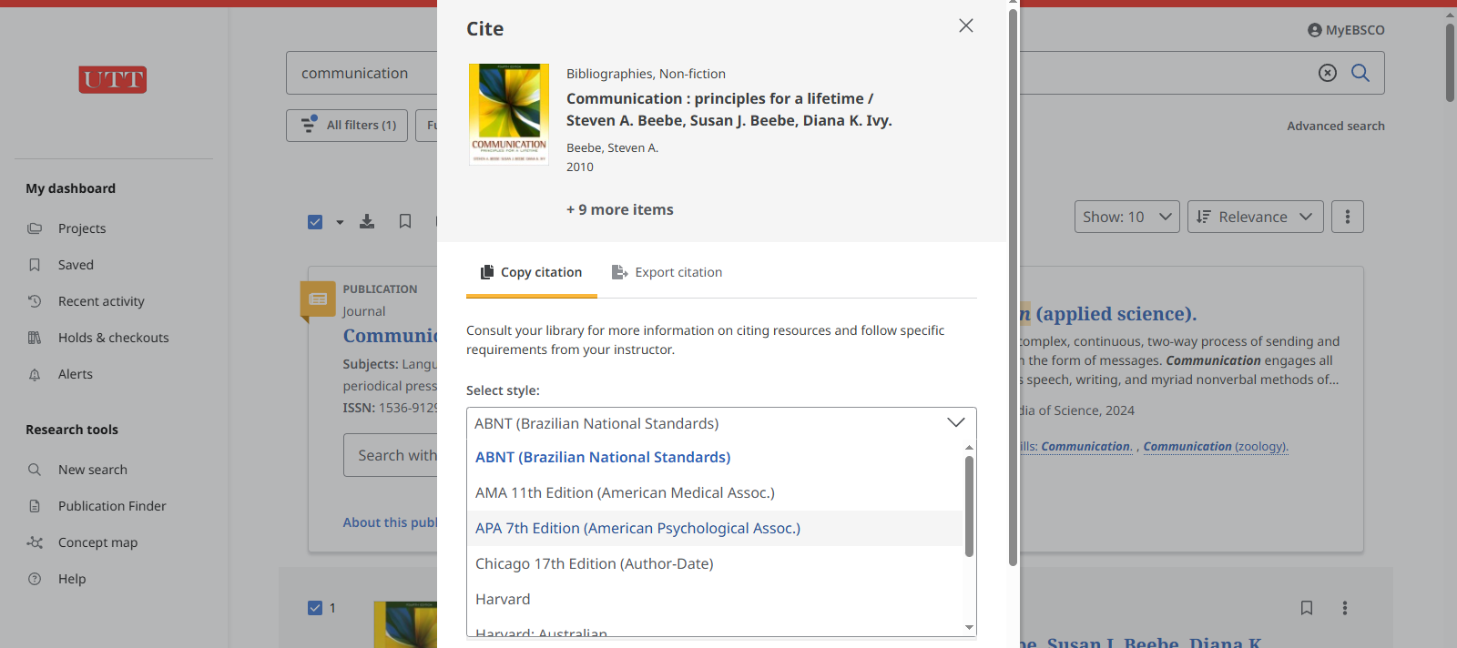
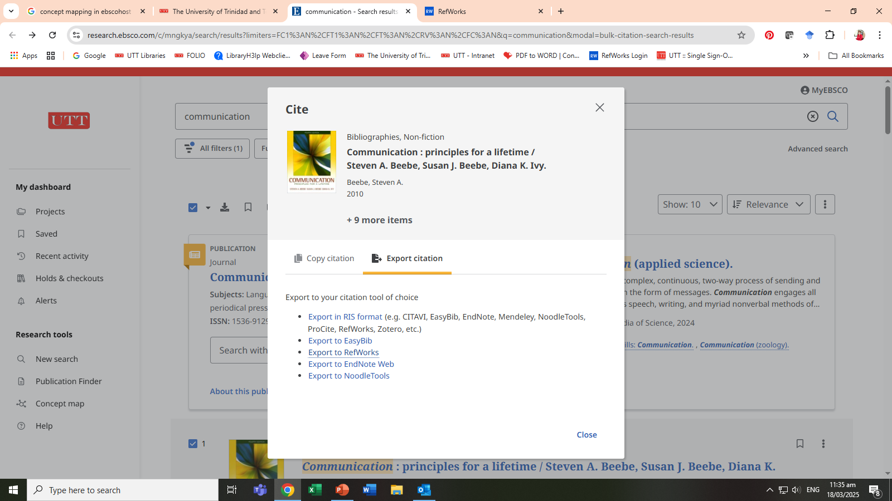
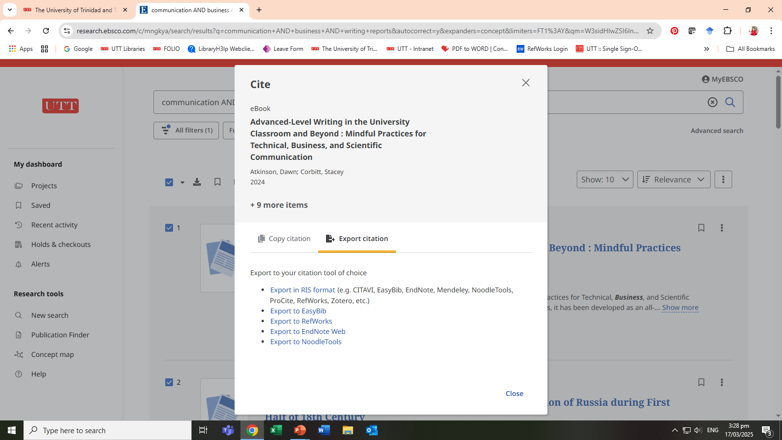
Export Items to RefWorks to Create Your References list:
Step 1:
Select items for use
Step 2:
Click on the Cite icon
Step 3:
Click on Export Citation
Step 4:
Click on Export to RefWorks

Slide 17
For Further Information, go to the Library’s Website
Chat With Us
Contact Us
Sign in for
On & Off Campus Access
through
My Campus
Email Us
Send us Feedback
Join our Facebook Group

