Slide 1
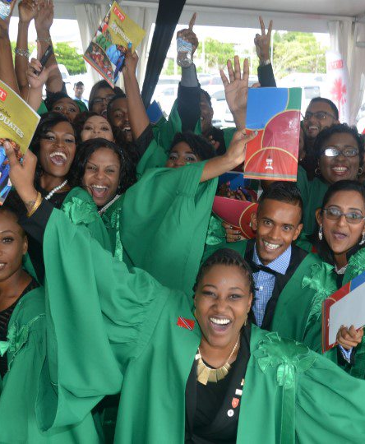
Class of 2025
Graduation Preparation:
Key Points to Note
The University of Trinidad and Tobago
November 2025
Congratulations students on your achievement!
This is your Graduation Rehearsal Guide to familiarize yourselves with the facilities and the processes.
This ensures that you are adequately prepared for your big day!

Slide 2
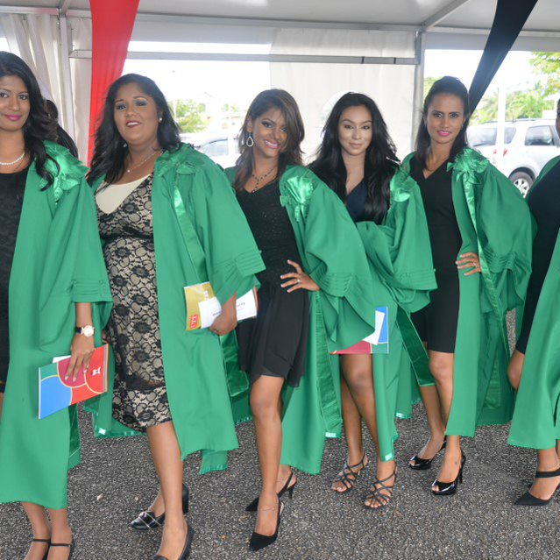
Greetings
You MUST KNOW:
Where to drop off your guests.
Where to park.
Where you are to assemble.
Where are your allocated robing spaces.
Where to collect your name cards.
All information is geared to provide you with a seamless student experience, we therefore urge you to pay particular attention to the information on the following slides.

Slide 3
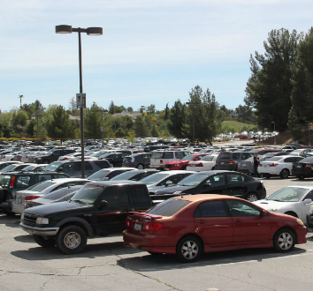
Drop Off & Parking
Parking has been reserved in the North Car Park, Queens’s Park Savannah;
The entry point to the designated parking areas is via Chancery Lane.
Graduating students should be dropped off at the Main Entrance of the Lord Kitchener Auditorium at the NAPA Building.

Slide 4
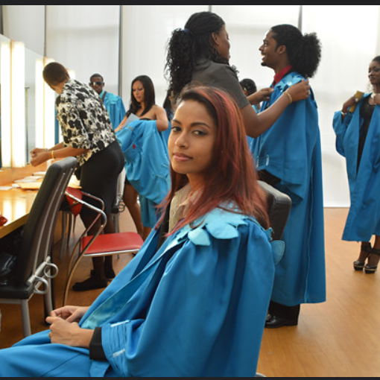
Direction to Allocated Robing Areas
Students must arrive at the venue two (2) hours before the start of the Ceremony.
Follow all signage and directions to find your assembly areas and robing spaces.
Once parked, guests MUST proceed to the Lord Kitchener Auditorium where they MUST present their invitations to enter.

Slide 5
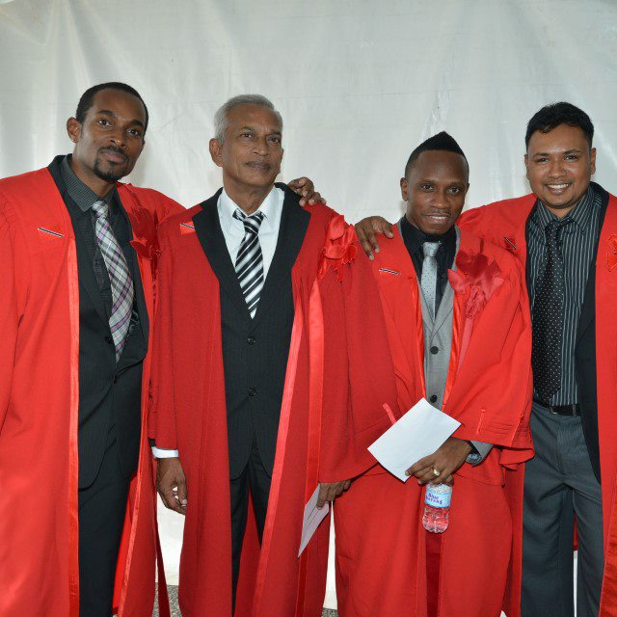
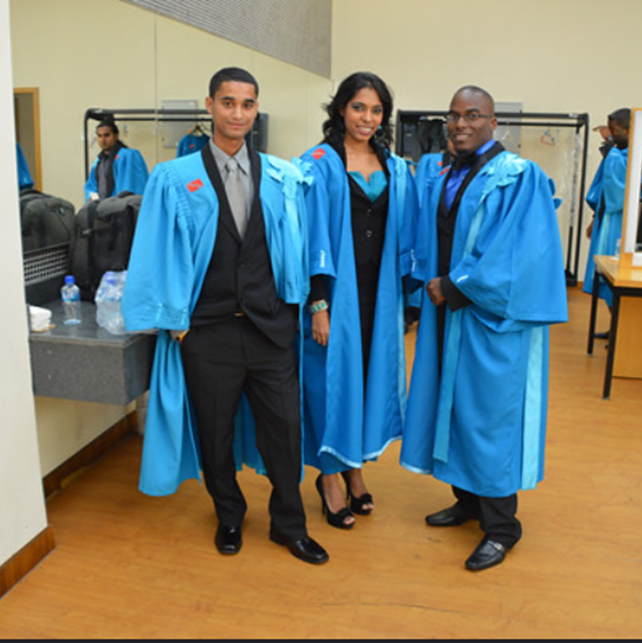
Direction to Allocated Robing Areas
Ensure that you are given your name card by the marshall of your group.
This card will be used to announce your name as you enter the stage.
YOU MUST secure your name card once it is assigned to you.
You will be seated alphabetically by name, program, and specialization.

Slide 6
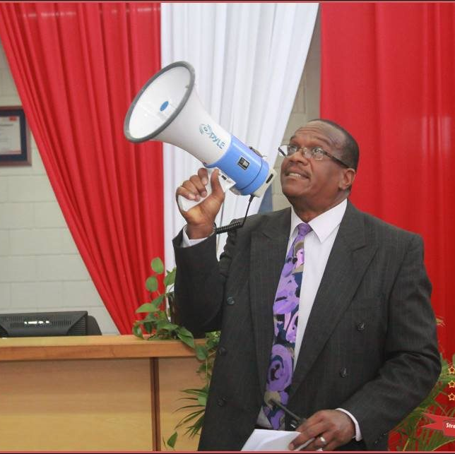
Pre-Ceremony Process
Pre-ceremony Checklist
Bathroom break
Makeup
Clothing
Secure personal belongings with your guests
Name card
Canister
Correct position in the procession

Slide 7
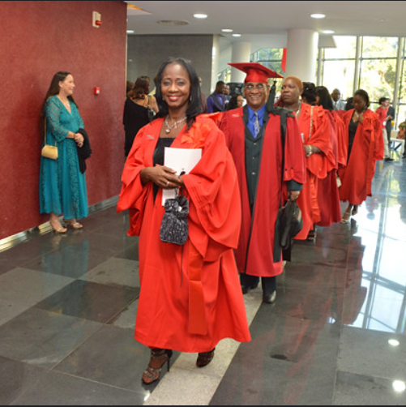
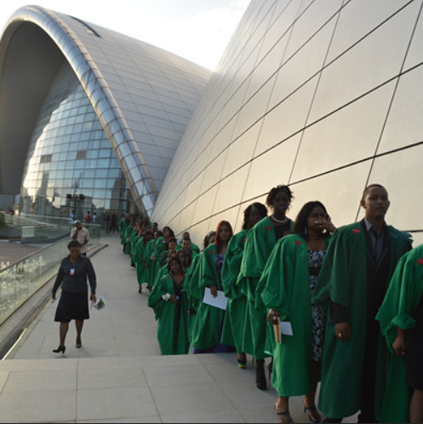
Procession
Listen for the call of the Grand Marshall and other Marshalls on duty.
Simply follow their instructions for the procession and seating.

Slide 8
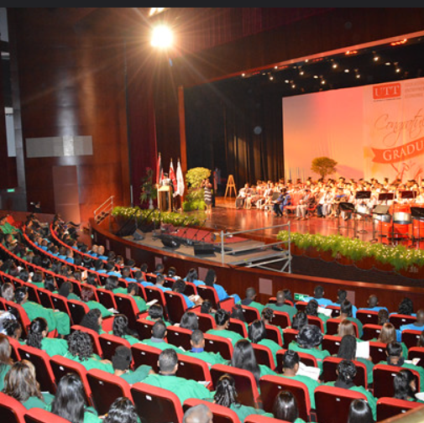
Seating
There will be assigned staff located in the auditorium to guide you to your seats.
Kindly note that graduands are not allowed to leave the Ceremony until it ends.

Slide 9
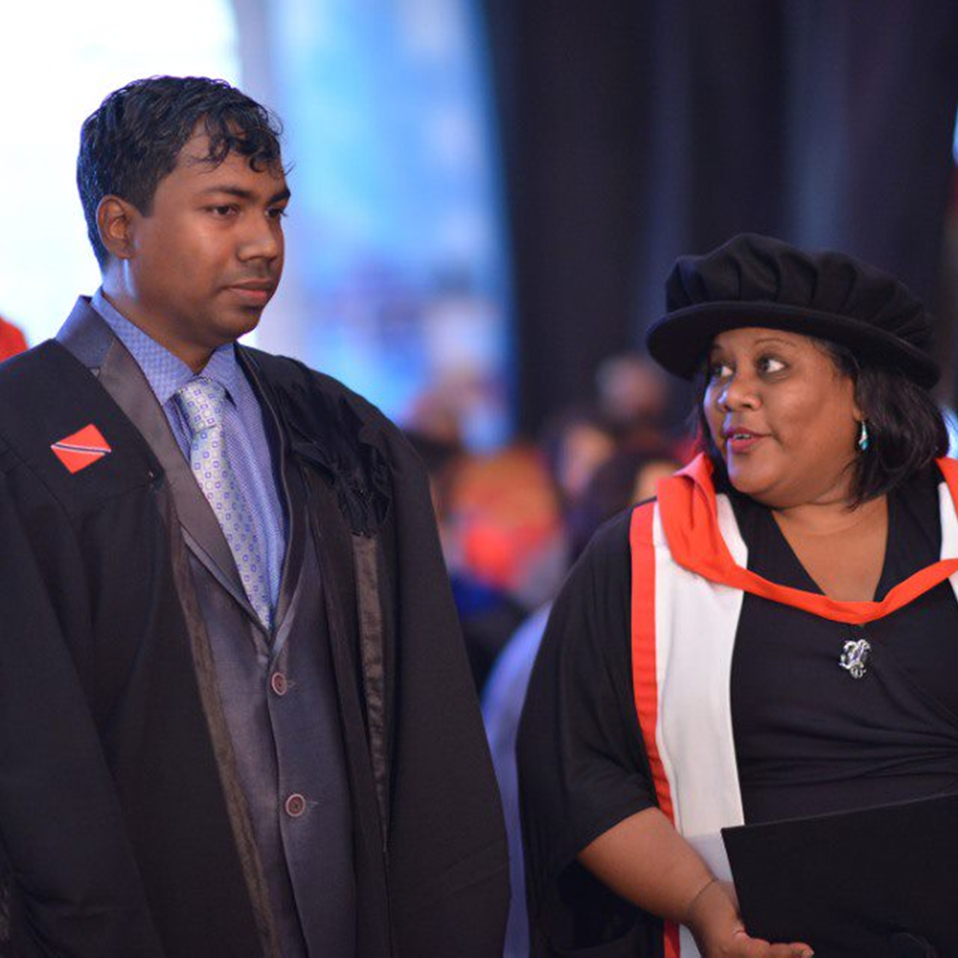
Stage Preparation – PHd Students
A marshall will signal to students and their supervisors when to get ready to approach the stage.
The student is escorted to the stage by their Academic Supervisor.
If the Academic Supervisor is seated on stage, they must meet their student at the stage entrance to escort them onto the stage.
The Academic Supervisor remains with the student throughout the stage process.
Kindly Note it is incumbent upon all Ph.D. students to be mindful of their chosen hairstyles or head covering on this day. It can delay or hinder the process of the Supervisor’s placement of the mortar board on the student’s head.

Slide 10
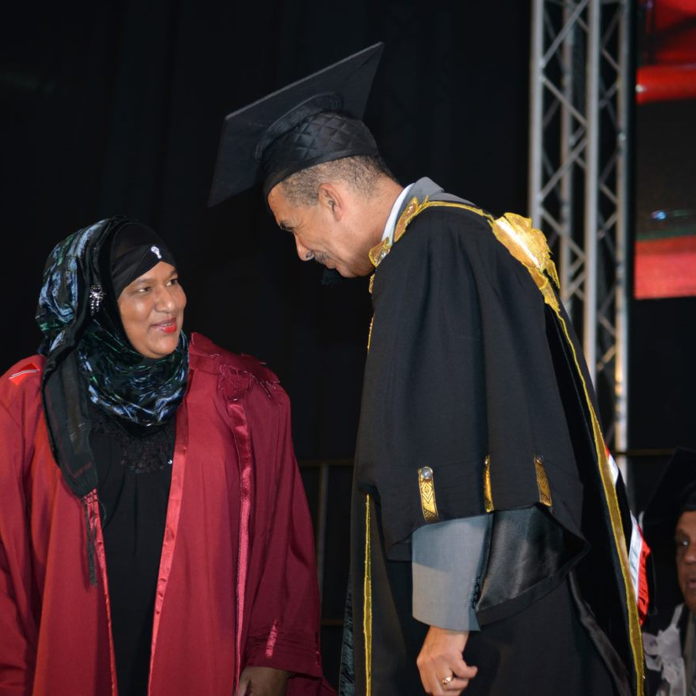
Stage Preparation – All Students
It is important to carry a posture of confidence as you receive your honor on this prestigious occasion – we therefore advise of the following:
Walk confidently as you take the stage.
Walk gracefully towards the Chancellor/Chairman facing them.
If you are an Islamic female or practice another faith or your preference is simply not to shake hands, kindly position your body to indicate this. Either place your hands behind your back or clasp them in front of you.
As you approach the Chancellor or Chairman, you can nod slightly in acknowledgment of him/her.
Repeat these instructions as you approach the University President.

Slide 11
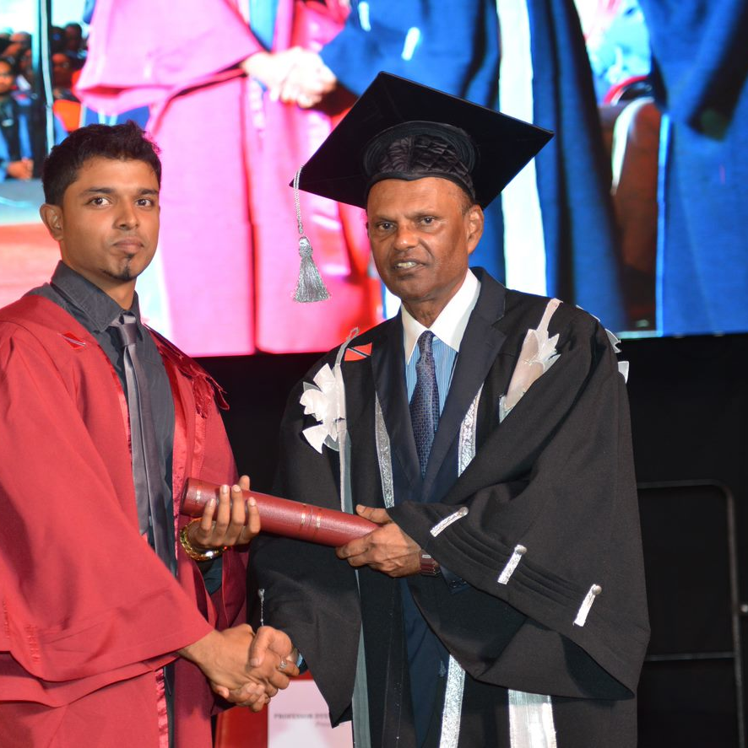
Stage Preparation Cont’d
Remember to turn and face the audience after saying thank you to the Chancellor/Chairman and the University President.
This is critical for your stage photo which will be posted on the UTT website after Graduation 2025.

Slide 12
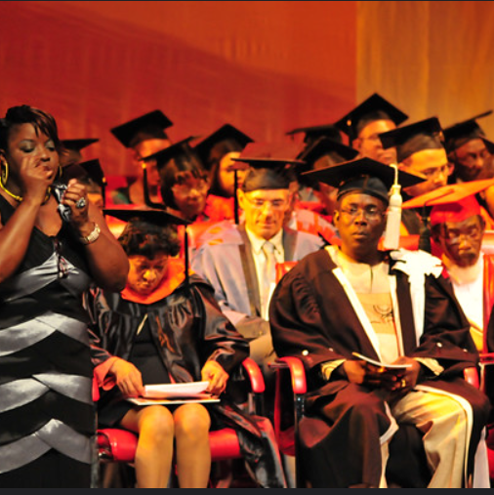
Stage Preparation
Follow all instructions and guidance given by the marshals as you enter and exit the stage, and return to your seats.

Slide 13

Recession
At the close of the Ceremony, the assigned staff and marshals will guide you for the recession where you will disperse to the Graduation Village, Student Guild’s Cocktail Reception, UTT APA lobby area.
Theatre 1 is assigned for Graduation Portraits.
Kindly note the following reminders:
Contact Mrs. Nicole Maloney for any Disabilities Access Services required (725-5742).
Visit the UTT website, Graduation Archives to view Graduation 2022-2024 held at NAPA. Pay close attention to the stage process.
We do hope that these instructions are helpful to you and you have a wonderful experience!
Congratulations from the
Student Support Services,
The University of Trinidad and Tobago

