Slide 1
FINDING A BOOK
IN THE LIBRARY
Using the Library of Congress (LC) Classification System

Slide 2
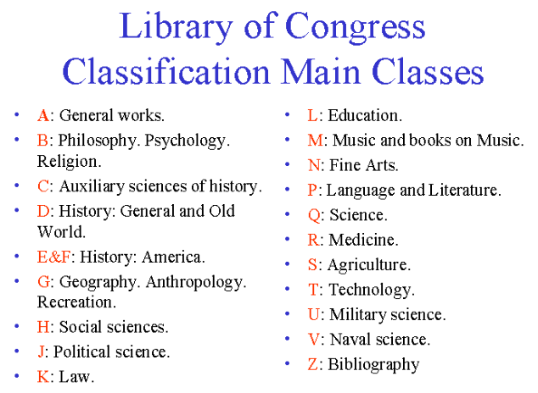
Books in the Library are grouped by subjects and arranged by the Library of Congress (LC) Classification System

Slide 3
The LC Classification System Call Number
The LC Classification System uses letters and numbers (LB 3013 .E94 2009) to arrange books in the Library so that books on the same subject (e.g. classroom management) are shelved together e.g. This arrangement results in "serendipitous browsing" i.e. you find one book in the catalogue, go to the shelf and an even better book is next to it.
Each book on the shelf has a unique identifier –
the Call Number - which comprises the
classification number and other features added
by the Library e.g.
LND
LB
3013
.E94
2009
no. 8

Slide 4
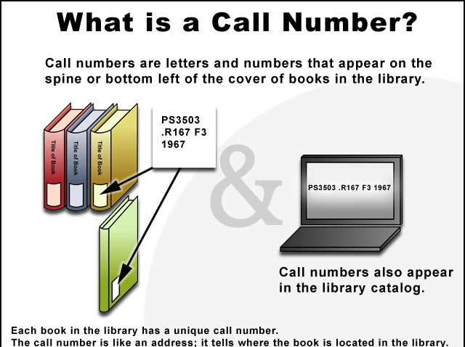
Books in the Library are organized by Call Numbers
LND
LB
3013
.E94
2009
no. 8
LB 3013 .E94 2009
Call numbers also appear in
the Library Catalogue

Slide 5
How do I read the Call Number?
From left to right & top to bottom
LNDLB
3013
.E94
2009
no.8
LND Refers to UTT Libraries’ Lending Policy
LB Refers to the general subject area of
the book: Theory & Practice of
Education
3013 Refers to the Specific subject:
School Management
.E94 Based on the author’s last name
[Evertson]
2009 The year the book was published
no. 8 = Copy Number

Slide 6


Interpreting the Call Number:
1. UTT Libraries’ Lending Policy & Copy Number
CALL NUMBER:
LND
LB
3013
.E94
2009
no. 8
The Lending Policy is at the top of the Call Number. These are: SL, LND, RES, *RES, REF (see below)
SL | Short Loan | 7 days
LND | Lending | 21 days
RES | Reserve | Overnight loan
*RES | *Reserve | For Library use only
REF | Reference | For Library use only
2. The Copy Number is at the end of the Call Number e.g.: no. 1, no. 2, no. 3 etc.
You can easily spot a SL item by the and a *RES item by the

Slide 7
Interpreting the Call Number:
2. How to read a Call Number on the shelves
Read Call Numbers on the shelves from: left to right, top to bottom, line by line
L before LA |  | LA before LB |  | 2395 before 2396 |  | .C645 before .C65 |  | 1991 before 1992
L 903 .C2 2001 | LA 11 .B53 2002 | LA 2899 .P87 1989 | LB 2395 .C65 1991 | LB 2395 .C65 1991 | LB 2396 .A771 1987 | LB 2395 .C645 1993 | LB 2395 .C65 1991 | LB 2395 .C65 1991 | LB 2396 .C65 1992
Books are shelved alphabetically by first letter/s Books are then arranged numerically by the number following the letter/s. Books are shelved alphabetically by the next letter and decimally by the following letter. Finally, books are shelved in numerical order by year.

Slide 8
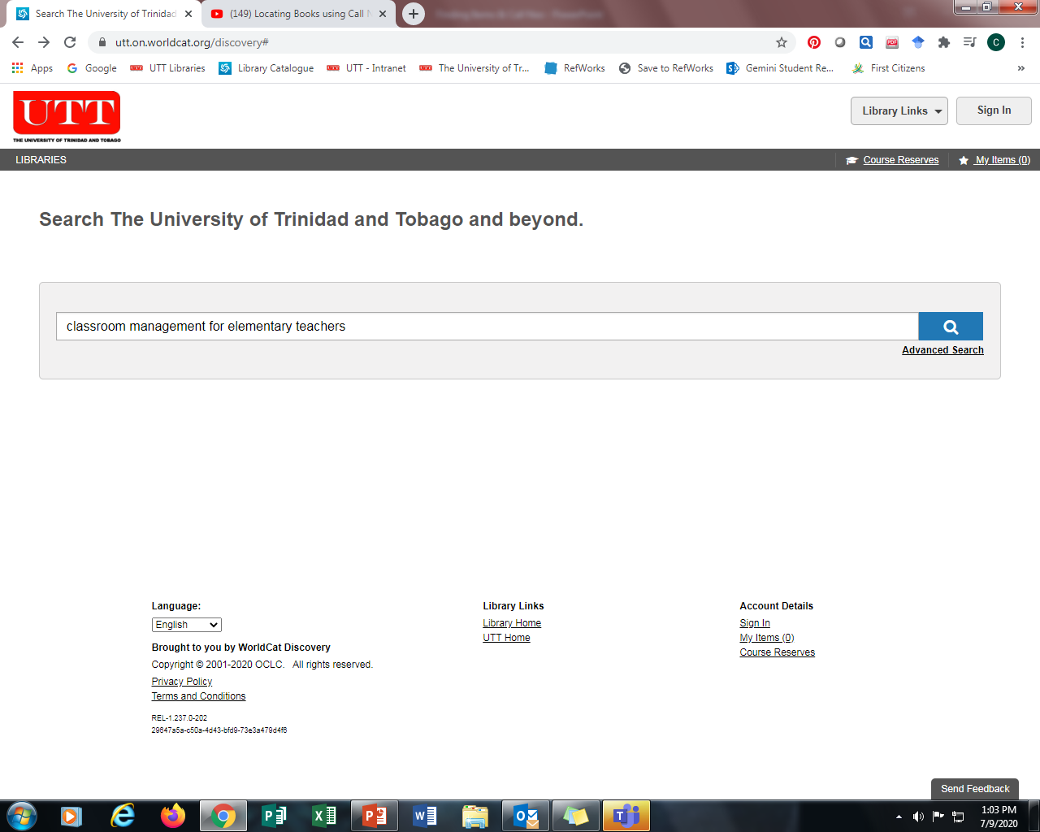
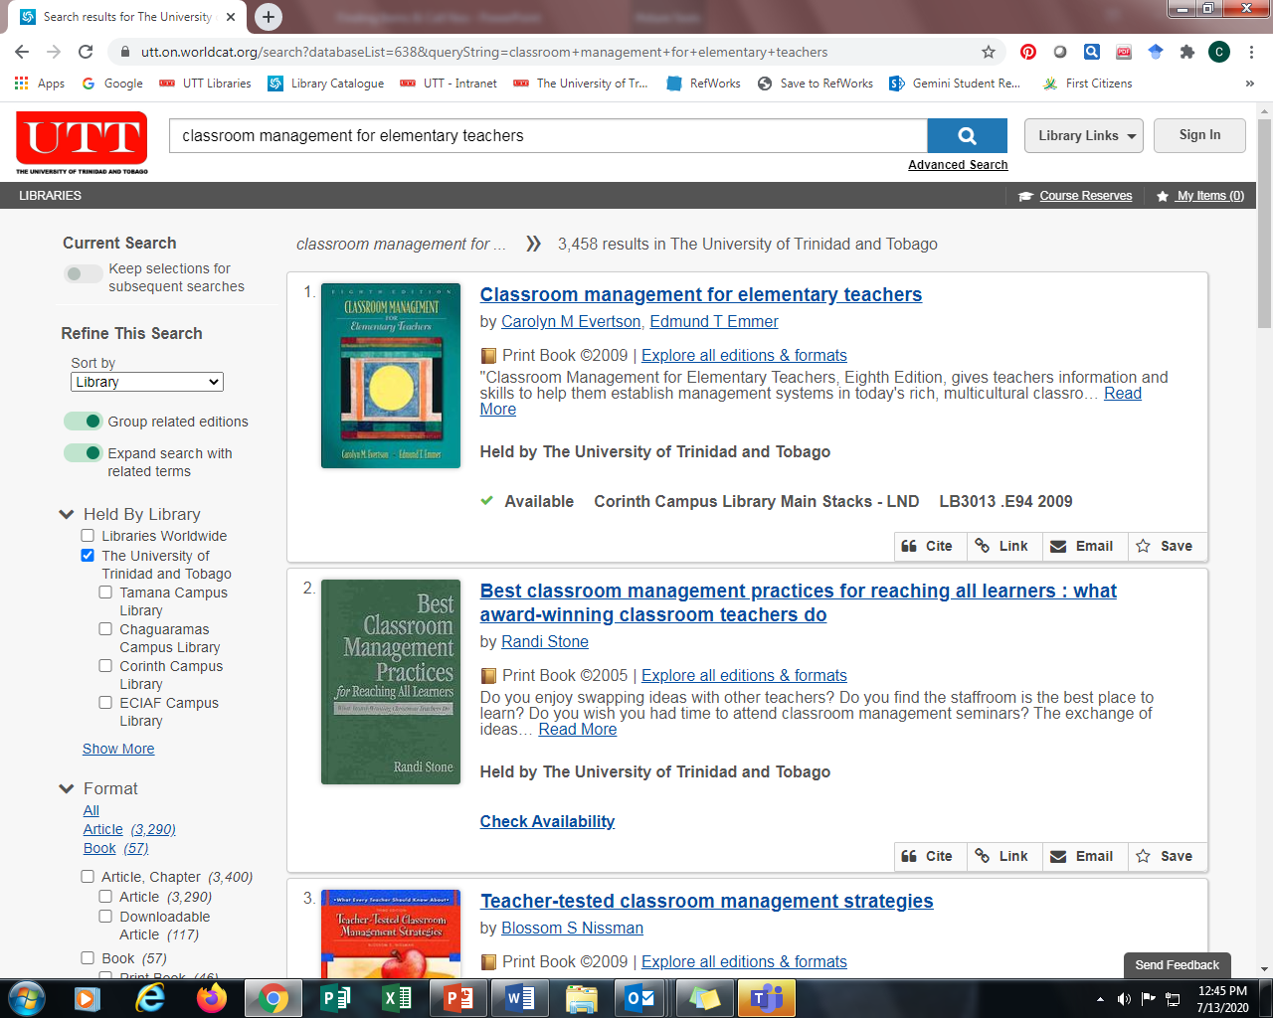
2. Use the Call number to find the book on the shelf
Finding a book using the Call Number:
1. Search the Library Catalogue
1. Search the Library Catalogue by any of the following:
Keyword e.g. classroom management
Author e.g. Evertson
Title e.g. Classroom management for elementary teachers
2. Use the Call Number (which is like the address of the book on the shelf) to find the book on the shelf

Slide 9
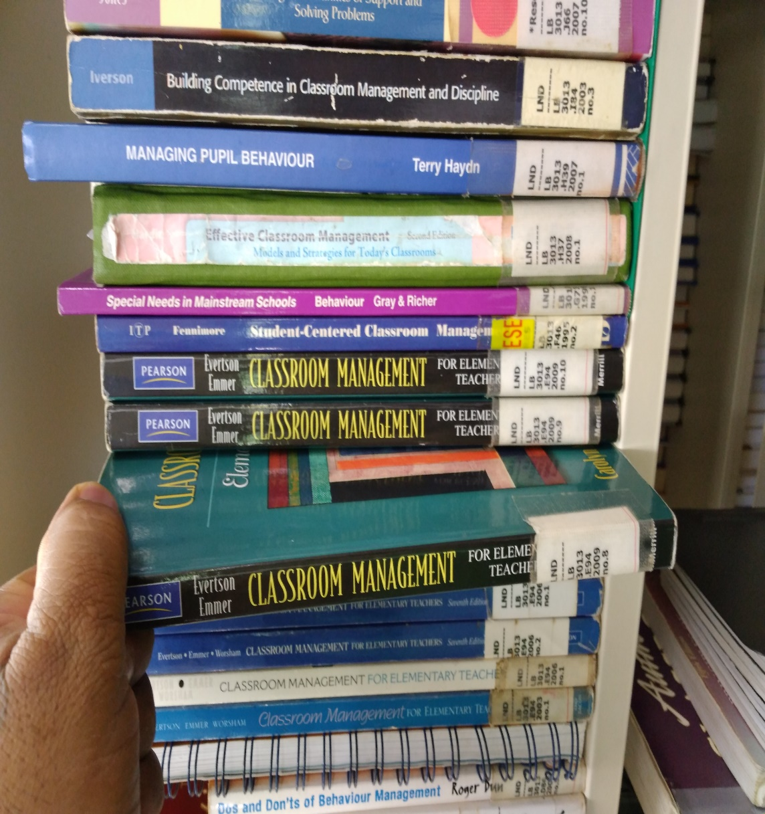
Finding a book using the Call Number:
2. Browse the shelves. Find other related books
CALL NUMBER:
LND
LB
3013
.E94
2009
no. 8

Slide 10
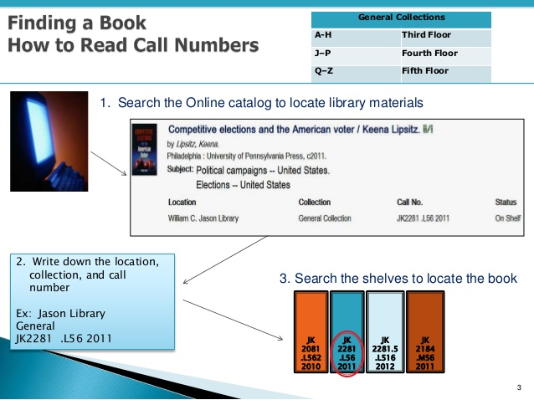
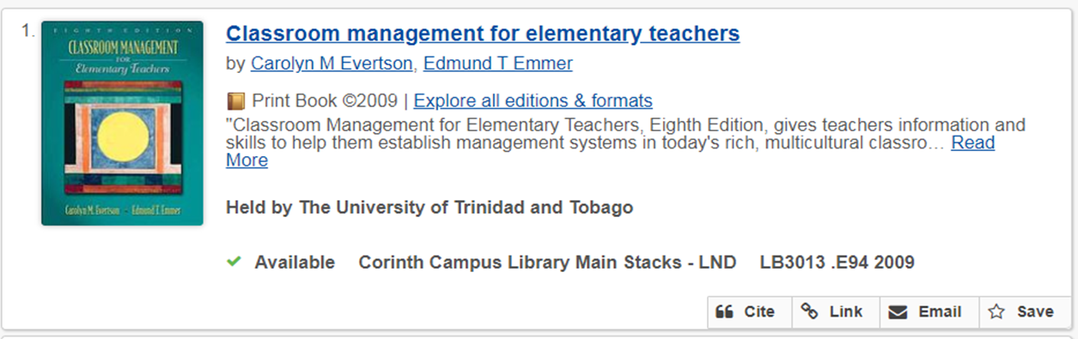
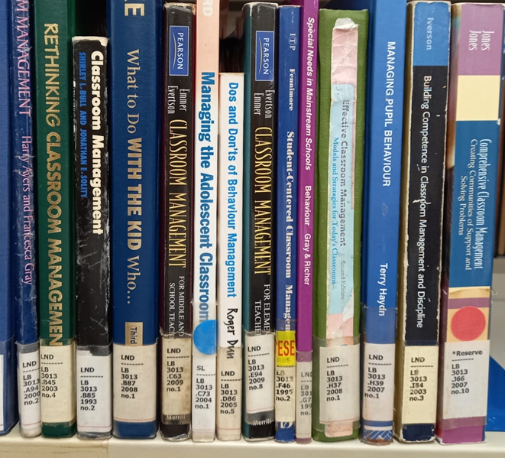
Summary:
Finding a book using LC Classification System
Reading Call Numbers:
1. In the Catalogue: from left to right
2. On the Shelf: from top to bottom &
left to right
Using LC Classification System
Search the catalogue to find the Call Number
2. Write down the Call Number
LB 3013 .E94 2009 and go to the shelves
LND
LB
3013
.E94
2009
no. 8

Slide 11
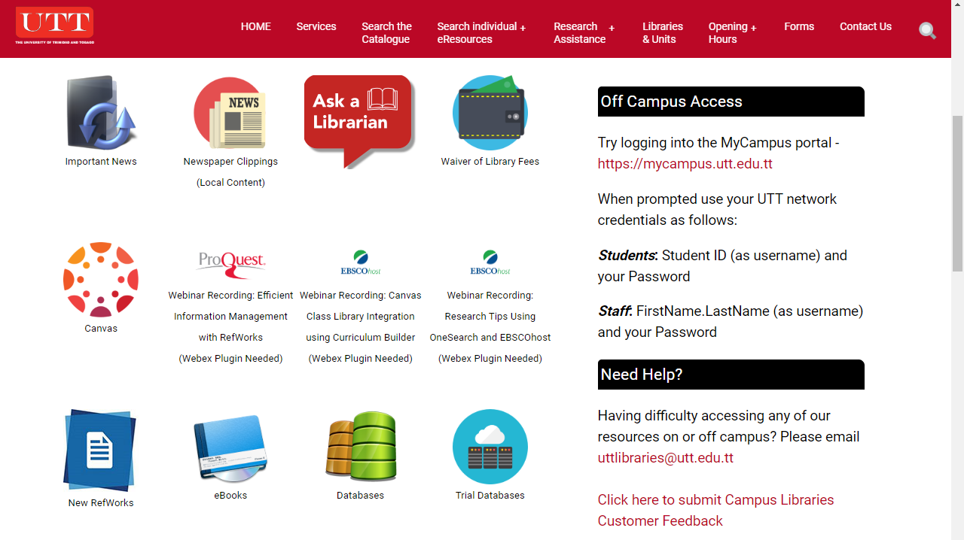
For Further Information:
Go to our Library Website
Chat with us Contact Us
Get
Off Campus Access
through
My Portal
Provide Feedback
Email us

