Slide 1

Development of Several Composite Indexes for Urban Intensity and Urban Ecosystem Services
Samantha Chadee Supervisor – Professor Valerie Stoute Department of Environmental Studies
Oral Defense
July 2015

Slide 2
Urban Ecosystems
A dynamic ecological space composed of the natural and built environments whose interactions are characterized by the cultural and socio – economic settings within urban areas

Slide 3
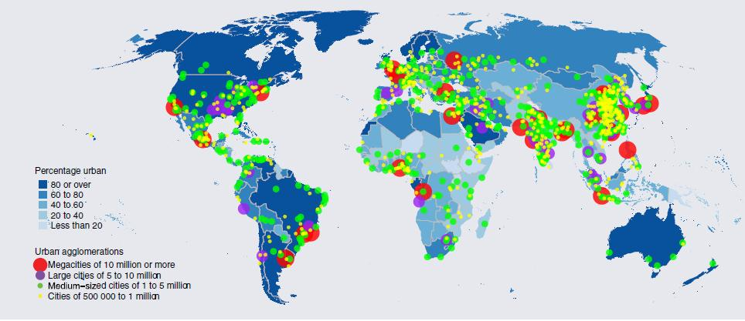
Global Urbanization
Currently more than 50% of the world’s population live in urban areas
Future projections indicate that populations within these areas, as well as the global urban acreage, will continue to increase - (United Nations, 2014)

Slide 4
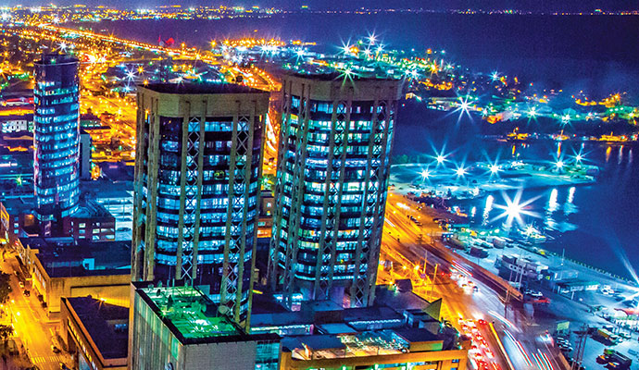
Urbanization in Trinidad and Tobago
Urban areas comprise 12% of the total land area
60% of the population live in urban areas
- (CSO, 2008)

Slide 5
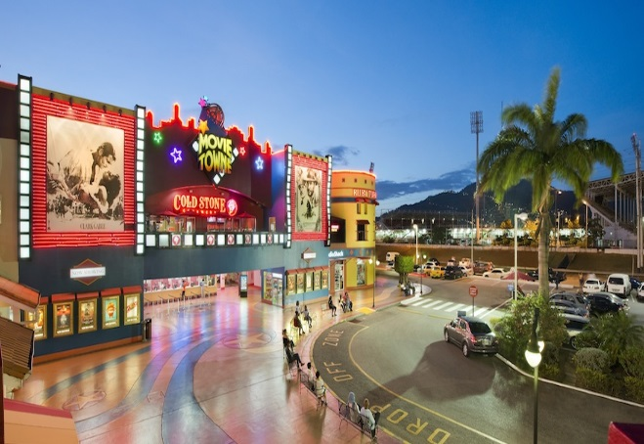

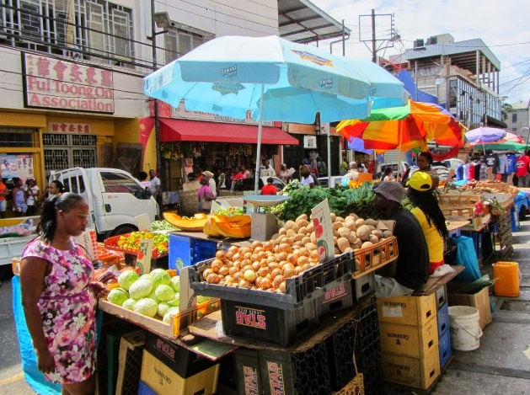
Importance of Urban Ecosystems
Centres of physical, social, economic and cultural development
They provide unique and diverse ecosystem services which are critical to quality of life
They are Sites of Social transformation and Innovation
Result in Changed Patterns of access to and demand for resources
Are Interconnected and impact upon rural systems
Opportunities for Sustainable Development

Slide 6
Urban Ecosystem Challenges
Strain on the environment and natural resources
Increased exposure to violence and crime, stress, social isolation & risk factors for disease
Unequal access to critical services
Increase in provision of certain ecosystem services are done at the expense of others

Slide 7
Mapping and Characterization of Urban Ecosystems – Capturing Urbanization
Establishing development paths which meet current quality of life requirements
Reducing environmental burdens
Preserving natural resources
Minimizing inequitable access and poverty
Thereby integrating the three pillars of sustainable development: environmental, social and economic sustainability

Slide 8
Usefulness of Indexes in Capturing Complex Constructs
The two most important purposes of composite indicators:
Summarizing dimensions of a concept
Enabling comparisons across countries, regions, communities, situations, and time
Indexes can provide stakeholders and decision makers with:
Direction of development
Assessment of state and trend in relation to goals and targets
A Communication channel between the general public and decision-makers- particularly true for social indexes

Slide 9
Rationale for Urban Intensity Index
Central to the mapping and characterization of urban ecosystems is the delineation of their boundaries
The delineation of urban ecosystem boundaries, is challenged by:
The lack of a universally accepted urban definition
The increasing ambiguity in urban boundaries as urbanization increases

Slide 10
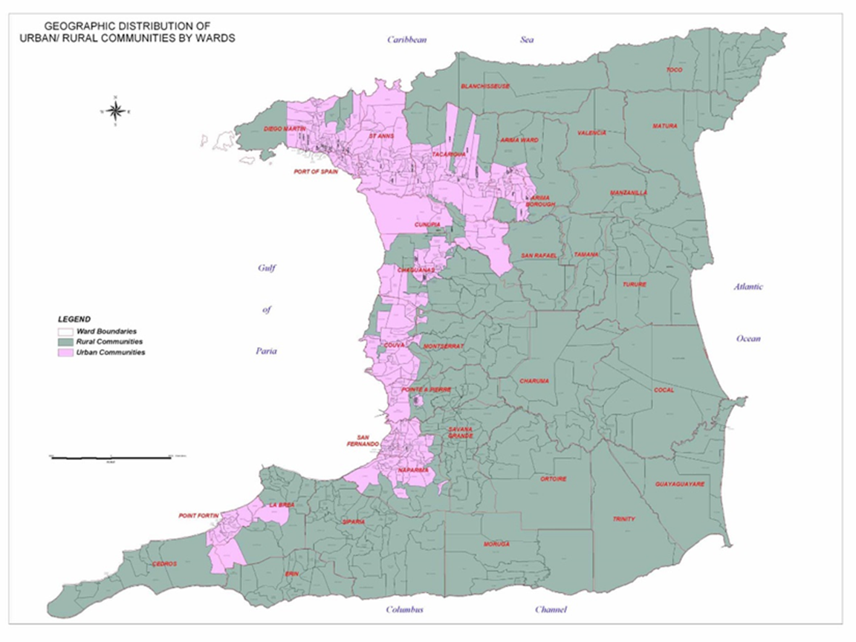
Urban Boundaries in Trinidad and Tobago
In Trinidad and Tobago, urban areas are characterized using an urban – rural dichotomy, primarily based on population density, agricultural density and element of remoteness from urban hubs

Slide 11
Limitations of the Urban- Rural Dichotomy
Making comparisons along the urban – rural gradient, can better elucidate the full range of urban effects as well as identify thresholds
Many economic and social characteristics considered typically urban are increasingly found among rural residents
General convergence in lifestyles between urban and rural areas - ICT and Transportation systems
Many people living in urban ecosystems do not have access to services which define urban infrastructure

Slide 12
Broad Overarching View of the Study
Develop a Statistically Validated Urban Intensity Index which is continuous
(Data from built environment)
Develop scales for urban Ecosystem Services
(Socio-Economic –Environmental Survey-SEES)
Change Scale data into indexes
Explore Correlation between Satisfaction and level of Service with changing Urban Intensity
Classify Urban Intensity Index into practical categories
(Cross-validate)

Slide 13
Construction of an Urban Intensity Index

Slide 14
Measuring Urban Intensity using the Gradient Approach
In the gradient approach to defining urban areas, urban and rural areas form the ends of a continuum as opposed to representing a dichotomy
The common approaches to urbanization gradients are based on:
distance from an urban core
broad nominal land use categories
urbanization indicators
The urbanization indicators based approach - combining different types of variables – is considered the strongest approach

Slide 15
Indexes
A composite index measures multidimensional concepts which cannot be captured by a single indicator
It can be defined as the aggregation of individual indicators into a single index on the basis of an underlying model
(Urbanization is MORE than just population density)

Slide 16
Schematic of Work Done
Part 1: Urban Intensity Index-development from physical data and classification
Part 2: Urban Ecosystem Services – development of service scales, survey data collection
Part 3: Development of Indexes for Ecosystem Services
Part 4: Exploring Possible Influences of Urban Intensity on Ecosystem Services

Slide 17
Urban Intensity Index Construction
Available Data (CSO)
Choice of Variables
(statistics)
Choice of Variable Weights
(statistics)
Elimination of Redundant Variables/
Validation of the Index
(statistics)
Classification of Index Values
(graphical)
Cross validation of the classification
(statistics)

Slide 18
Urban Intensity Index
Data was acquired at the community level – 581 communities
52 selected initial physical descriptors
The data was standardized by calculating densities and community proportions for each variable across the 581 communities

Slide 19
Urban Intensity Index – Cluster Analysis
Several Hierarchical Cluster Analysis routines were conducted to discern the most discriminating variables in the data:
‘agglomerative’ method of clustering
‘between groups linkage’ method of clustering
‘squared Euclidean distance’ option was selected as a similarity measure
The optimum cluster solution was estimated from the resulting icicle plots and agglomeration schedules

Slide 20
Urban Intensity Index – Cluster Analysis
A comparison was done of the cluster-to-cluster differences in the means and standard deviations for each of the variables
The variables with the largest inter-cluster gaps were selected as the most discriminating
This resulted in the selection of 29 variables from the initial 52

Slide 21
Categories | Variables
Demographic and Built Environment | Population Density
 | Household Density
 | Building Density
 | Dwelling Density
 | Business Density
 | Institution Density
 | Agricultural Density
Utilities | Internet Access
Land Tenure | Squatting
Type of Water Supply | Public Piped into Yard
 | Private Piped into Dwelling
 | Public Piped into Dwelling
 | Spring/River/Well/Pond Water Supply
 | Public Standpipe Water Supply
 | Truck Borne Water Supply
 | Private Catchment
Categories | Variables
Building Type | Residential/Commercial Buildings
Dwelling Type | Townhouses and Duplexes
 | Flats/Apartments
Environm-ental Issues | Flooding
 | Air Pollution
 | Deforestation
 | Sewage
 | Solid Waste
 | Water Contamination
 | Wastewater
 | Excess Noise
 | Drainage
Chronic Illness | Diabetes

Slide 22
Urban Intensity Index - Factor Analysis
Independent (orthogonal) multidimensional latent Factors were extracted from the original data as Principal Components
Varimax rotation
Factor Scores and score coefficients were saved
General solution – number of Factors and the variance explained by each Factor. Factors are named according to the variables with which each is correlated substantially (loading >0.5)

Slide 23
Urban Intensity Index - Factor Analysis
Goodness of fit for each solution was estimated from:
The magnitude of the values of the off-diagonal (close to 0.0) and diagonal (close to 1.0) elements of the Anti-image correlation matrix
The Kaiser Meyer Olkin (KMO) measure of sampling adequacy
The results of Bartlett’s test for sphericity ( p < 0.05)
The solution set was restricted to Factors with eigen values ≥ 1.0

Slide 24
Factor Solution
Factor Names- 68.% | % Variance
1 – The Built Environment | 14.7
2 – Utilities: Internet and Piped Water | 9.4
3 – Activity: Socio Economic | 7.5
4 – Infrastructure Problems I: Flooding, Drainage, Health | 7.4
5 – Infrastructure Problems II: Sewage and Waste | 7.3
6 – Environmental Problems: Deforestation and Water contamination | 5.1
7 – Squatting | 5.0
8 – Townhouse Density | 4.4
9 – Agricultural Character | 3.9
10 – Rural Access | 3.7

Slide 25
Determination of Variable Weights
The index weights were derived by summing, over the ten Factors, the product of the score coefficient for the variable in a Factor by the variance explained by that Factor:
Weight of indicatorj = wj = Σ^{n}_{i=1}V_{i} x β_{ij}
β_{ij} is the score coefficient for the j^{th} indicator in the i^{th} Factor and V_{i} is the percentage of the variance in the dataset explained by the i^{th} Factor

Slide 26
Aggregation of Variables into the Index
(U.I.I)_{i} = Σ²⁶_{j=1} (C_{ij}.w_{j})
where (U.I.I)_{i} is Urban Intensity Index score for community i, C_{ij} is the value of indicator j in community i, wj is the weight of indicator j

Slide 27
Elimination of Redundant Variables/ Validation
The Urban Intensity Index was statistically validated using Multiple Regression analysis of both the Orthogonal Factors and the Original Variables used -
Stepwise regression
The Durbin-Watson measure was estimated to test the independence of residuals
Collinearity statistics – estimates of Tolerance , VIF-variance inflation
R² and R²_{adj} - compared to determine the extent of variance inflation
All regression assumptions of Normality & homoscedasticity of residuals were tested

Slide 28
Regression Analysis with Factors
Model |  |  | Unstandardized Coefficients |  | Standard Coeff | t | Sig.
 |  |  | B | Std. Error | Beta
 | (Constant) |  | 66082.46 | 517.8 |  | 127.6 | 0.00
 |  | Built Environment | 91225.14 | 518.3 | 0.959 | 176.0 | 0.00
 |  | Socioeconomic Activity | 15184.62 | 518.3 | 0.160 | 29.3 | 0.00
 |  | Utilities ( Internet & Piped Water) | 13091.73 | 518.3 | 0.138 | 25.3 | 0.00
 |  | Infrastructure Problems I (Flooding, Drainage, and Health) | -8555.32 | 518.3 | -0.090 | -16.6 | 0.00
 |  | Townhouse Density | 6541.67 | 518.3 | 0.069 | 12.6 | 0.00
 |  | Infrastructure Problems II ( Sewage and Waste) | 5727.82 | 518.3 | 0.060 | 11.1 | 0.00
 |  | Agricultural Cultivation | 3731.23 | 518.3 | 0.039 | 7.2 | 0.00
 |  | Lack of Access | 1067.98 | 518.3 | 0.011 | 2.1 | 0.04
Dependent Variable: Urban Intensity Index Value R² = 0.983, R²_{adj} =0.983, Durbin-Watson statistic =1.835

Slide 29
Regression Analysis with Original Variables
Repeated Regression Analyses, using the collinearity statistics to remove redundant variables, resulted in extraction from the full index dataset (29 variables) to 7 predictors
99.5% of the variation in Urban Intensity Index scores is explained by the model with the original variables
U.I.I. (R) = 1281.59 + 185.92 (Household Density) -16496.8 (Flats/Apartments) + 24.62(Business Density) + 3352.73(Public Piped Water into Dwelling) + 129.5(Agricultural Density) -505.84(Institution Density) -8219.57(Townhouses/Duplexes)

Slide 30
Index Means for Regions in Trinidad

Slide 31
Index Means for Parishes in Tobago

Slide 32
Urban Intensity Index Classification- practical necessity
Classification of the Urban Intensity Index provides a measure of urban intensity that is at a scale between the community and the regional level -
Difficulty in ascertaining important trends from a community by community comparison
Heterogeneity in urban intensity within regions and parishes
Rendering the index a more practical tool for decision makers and other stakeholders

Slide 33
Urban Intensity Index Classification
The frequency distribution of the index scores was studied to determine the appropriate points for sub-division of the index
The total range of index values for the 581 communities was sub-divided once into 10 classes and once into 8 classes of increasing urban intensity

Slide 34
Index Ranges for the 10 and 8 Category Index Classifications
Urban Intensity Class | Classification
 | 10 Categories | 8 categories
1 | less than 5, 000 | less than 25 000
2 | 5, 000 to 14, 999 | 25 000 to 74 999
3 | 15, 000 to 24, 999 | 75 000 to 124 999
4 | 25, 000 to 74, 999 | 125,000 to 199, 999
5 | 75, 000 to 124, 999 | 200, 000 to 249,999
6 | 125, 000 to 199, 999 | 250 000 to 324 999
7 | 200, 000 to 249, 999 | 325,000 to 399,999
8 | 250, 000 to 324, 999 | 400, 000 or greater
9 | 325, 000 to 399,999
10 | 400,000 or greater

Slide 35
Classification Validation – Goodness of Fit
Discriminant analysis was conducted to test the validity of the two classifications of the Urban Intensity Index values
The goodness of fit of the classification was estimated from the matrix of classification results

Slide 36
Discriminant Analysis Assumptions
Assumptions tested for residuals and predictors:
Independence (or collinearity of predictors)
Homoscedasticity
Multivariate Normality
In addition:
Equal covariance matrices checked with Box’s M test
Class means and standard deviations were compared to ensure that there were no patterns

Slide 37
Discriminant Analysis Classification Results
CLASSIFIC- -ATION | INDEPENDENT VARIABLES | CORRECT % CLASSIFICATION
 |  | SELECTED CASES | UNSELECT-ED CASES | CROSS-VALIDATED CASES
10 CLASSES | 10 FACTORS | 71.0 | 61.0 | 65.1
8 CLASSES | 10 FACTORS | 89.1 | 80.2 | 85.6
10 CLASSES | 7 Original Variables | 69.3 | 65.0 | 65.6
8 CLASSES | 7 Original variables | 92.3 | 93.2 | 89.6

Slide 38
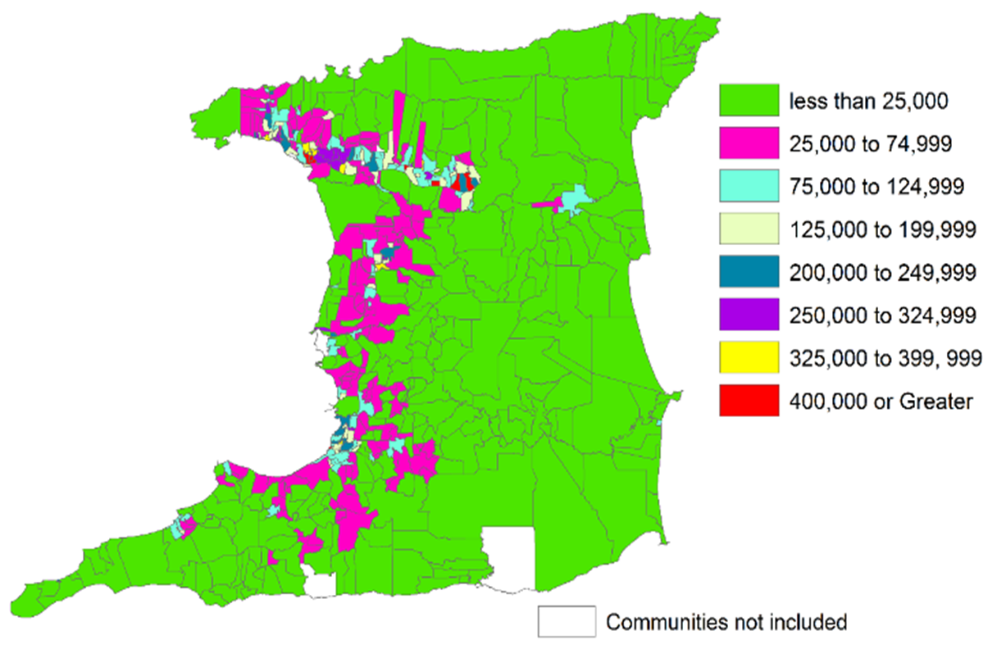
Distribution of Index Classes - Trinidad

Slide 39
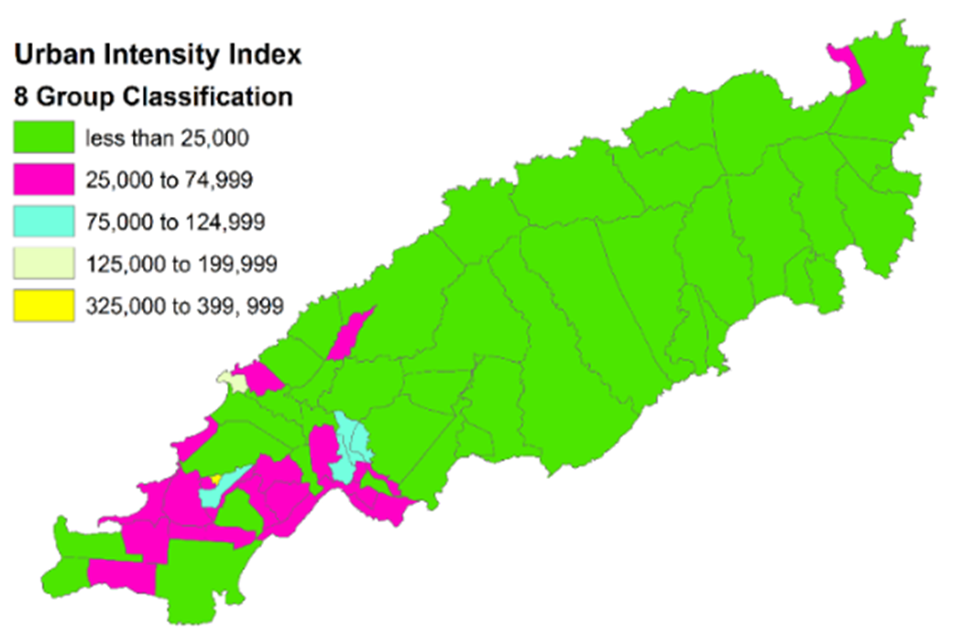
Distribution of Index Classes - Tobago

Slide 40
Region | Urban Intensity Class
 | 1 - >25,000 | 2 - 25,000 to 74,999 | 3 - 75,000 to 124,999 | 4 - 125,000 to 199,999 | 5 - 200,000 to 249,999 | 6 - 250,000 to 324,999 | 7 - 325,000 to 399,999 | 8 – ≥400K
Arima | 0 | 28.6 | 0 | 14.3 | 14.3 | 14.3 | 0 | 28.6
Port of Spain | 0 | 15.4 | 15.4 | 23.1 | 7.7 | 15.4 | 15.4 | 7.7
San Fernando | 0 | 0 | 28.6 | 28.6 | 28.6 | 4.8 | 4.8 | 4.8
San Juan\ Lav | 23.7 | 28.9 | 10.5 | 10.5 | 2.6 | 13.2 | 5.3 | 5.3
Tuna\ Piarco | 29.9 | 23.9 | 20.9 | 11.9 | 3.0 | 6.0 | 1.5 | 3.0
Diego Martin | 11.1 | 33.3 | 17.8 | 15.6 | 11.1 | 8.9 | 2.2 | 0
Chaguanas | 11.1 | 44.4 | 11.1 | 16.7 | 5.6 | 5.6 | 5.6 | 0
St Patrick | 35.7 | 57.1 | 0 | 0 | 0 | 0 | 7.1 | 0
Cva\ Tab \Tal | 53.8 | 31.9 | 9.9 | 2.2 | 1.1 | 1.1 | 0 | 0
Penal\Debe | 46.4 | 35.7 | 14.3 | 3.6 | 0 | 0 | 0 | 0
Point Fortin | 27.3 | 27.3 | 36.4 | 9.1 | 0 | 0 | 0 | 0
Princes Town | 55.1 | 36.7 | 6.1 | 2.0 | 0 | 0 | 0 | 0
Siparia | 71.7 | 23.3 | 3.3 | 0 | 1.7 | 0 | 0 | 0
St Andrew | 17.6 | 58.8 | 23.5 | 0 | 0 | 0 | 0 | 0
St David | 70 | 20 | 0 | 10 | 0 | 0 | 0 | 0
St John | 87.5 | 12.5 | 0 | 0 | 0 | 0 | 0 | 0
Rio\ Mayaro | 96.2 | 0 | 3.8 | 0 | 0 | 0 | 0 | 0
SangreGrande | 95.0 | 2.5 | 2.5 | 0 | 0 | 0 | 0 | 0
St George | 100 | 0 | 0 | 0 | 0 | 0 | 0 | 0
St Mary | 100 | 0 | 0 | 0 | 0 | 0 | 0 | 0
St Paul | 100 | 0 | 0 | 0 | 0 | 0 | 0 | 0

Slide 41
UII Construction-Highlights
An Urban Intensity Index (UII) is built systematically
UII scores have been estimated
The Index is further reduced to 7 predictors
every step is directed and/or validated via a statistical approach
easily measurable, relatively uncorrelated predictors
for 581 communities
Validated Classification of the entire range of index values
GIS Maps
- into eight groups of increasing urban intensity with successful classifications of greater than 90%
Regions, Index community distributions and urban intensity classes

Slide 42
Construction of Ecosystem Services Scales and Indexes

Slide 43
Urban Ecosystem Service Metrics (survey scales)
Development of a data collection instrument
Comprised of seven (7) multidimensional scales
Administered online via Survey Monkey®
Target Respondents –Residents of Trinidad and Tobago

Slide 44
Urban Ecosystem Service Metrics- Indexes
SCALES
manifest responses
LATENT VARIATES
pertinent variances
SCALE SCORES
weighted averages
INDEX
Coefficients and variables (scale statements)

Slide 45
Demographics of Respondents
Respondents were:
54.4% Female
57.7% Employed
Majority were within the age group 18 to 25
80% had at least a secondary school education
The majority of employed respondents were Government workers, working in various industries, the most common was the education industry

Slide 46
Demographics of Respondents
Data was obtained from 561 Respondents
Respondents were from various communities within all 14 regional corporations and municipalities in Trinidad and communities in Tobago
Scales
All Scales were designed as intensity interval scales: from ‘0’ to ‘5’

Slide 47
Description of Survey Scales
Ecosystem Services Scales
Overall Satisfaction – 26 Items
Environmental Quality – 22 Items
Positive Environmental Behaviour – 25 Items
Total Access – 73 Items
Freedom – 14 Items
Disturbance – 17 Items
Recreation and Culture – 50 Items

Slide 48
Total Access Sub – scales
Transportation
Employment
Safety and Protective Services
Health Care
Utilities
ICT
Education
Political Representation
Commerce and Banking

Slide 49
Reliability of Scales
Scales and Sub-Scales | Cronbach's Alpha
Total Access | 0.94
Transportation Access | 0.79
Health Care Access | 0.88
Safety and Protective Services Access | 0.89
ICT Access | 0.78
Utilities Access | 0.51
Education Access | 0.62
Employment Access | 0.63
Commerce and Banking Access | 0.93
Political Representation Access | 0.95
Environmental Quality | 0.77
Positive Environmental Behaviour | 0.91
Freedom | 0.65
Recreation and Cultural | 0.92
Disturbance | 0.66
Satisfaction | 0.90

Slide 50
Ecosystem Services Scales
Exploratory Factor Analysis (EFA) was conducted on all scales to measure the latent dimensionality of the complex construct captured by each

Slide 51
Ecosystem Services Indexes
Scales (list of survey items) were converted to Indexes (scale Items and associated coefficients), using previously detailed methodology
The 561 survey respondents were assigned a community ID number → a UII score → UII class number, depending on residence

Slide 52
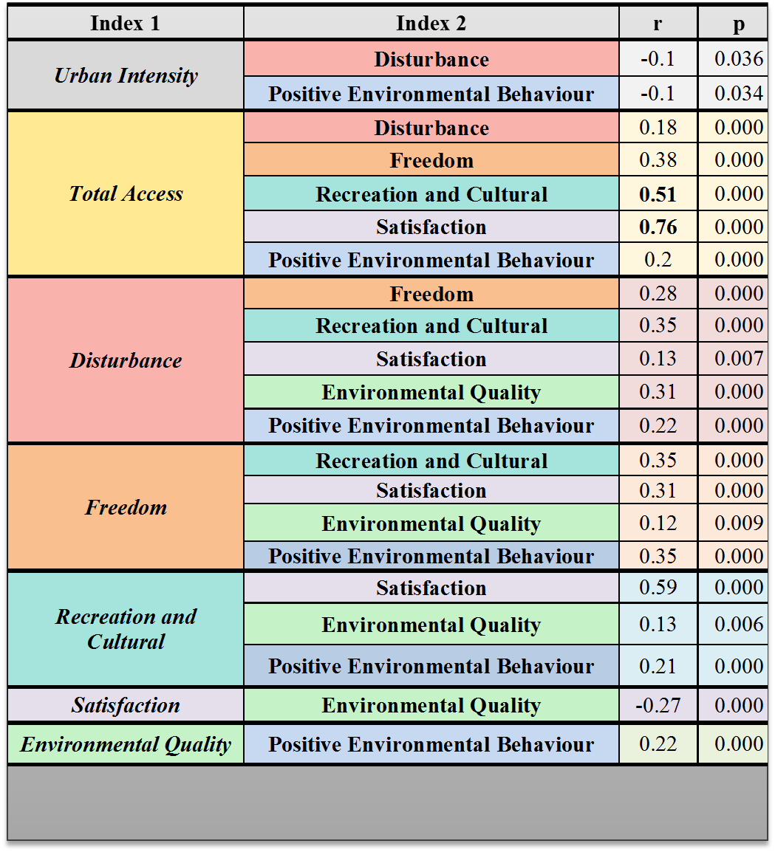

Slide 53
Regression with Indexes
The Ecosystem Services Satisfaction Index was modeled, using as predictors in a Regression Analysis, the other six Ecosystem Services indexes and the Urban Intensity Index, UII(R)
Positive Environmental Behaviour, Freedom, Disturbance, and the Urban Intensity indexes are all excluded from the final model
The model explains 71% (R² = 0.71) of the variance in the Satisfaction index scores with Total Access as the most impactful predictor
Satisfaction = 27.8 + 0.537 x Total Access -0.247 x Environmental Quality + 0.038 x Recreation & Culture

Slide 54
Ecosystem Socio-Environmental-Economic Indexes -Highlights
Original and Extensive Ecosystem Services Survey Instrument
has been administered and has provided data for the estimation of seven indexes
Seven Indexes & nine sub - indexes Constructed
Each of the indexes is constructed using the same methodology as that used for the UII
A Regression Model is obtained for the Satisfaction index
71% of the variance explained with Total Access, Environmental Quality, and Recreation and Culture as predictors
Total Access Sub – Scales
The nine (9) components of the Total Access Scale are considered as sub - scales

Slide 55
Profiling Urban Ecosystem Service Behaviour within each UII Class

Slide 56
Exploring Possible Influences of Urban Intensity on Ecosystem Services
Separation of Social index values by Urban Intensity Index class, using class for respondent’s residence
Analysis of the Profiles of Ecosystem Services Indexes across Urban Intensity Index Classes
Class by class standardization ( z values) for each Ecosystem Services Index-
Class by Class Probability Distributions ( z values)-
mathematical descriptions of behaviour

Slide 57
Profiles of Index Behaviour in each UII(R) Class
Class Means
  For each index, class means can be plotted against UII classes to show behaviour of the index
Index Probability Profiles for each UII class
  The original index values are standardized for each UII class using the mean and standard deviation values for the particular class
  These standardized (z) scores are plotted as histograms, one for each urban intensity class
  This was done for each of the 7 Ecosystem Services Survey indexes

Slide 58
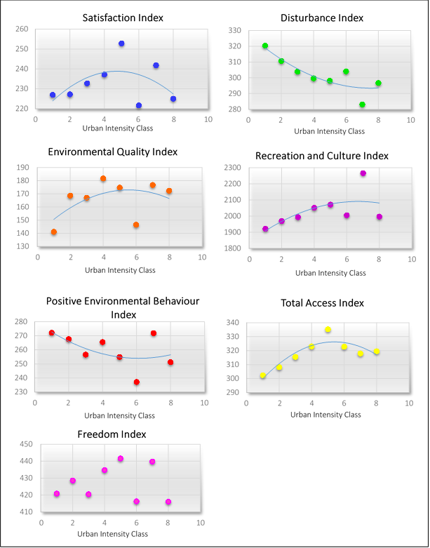
Index Class Means

Slide 59
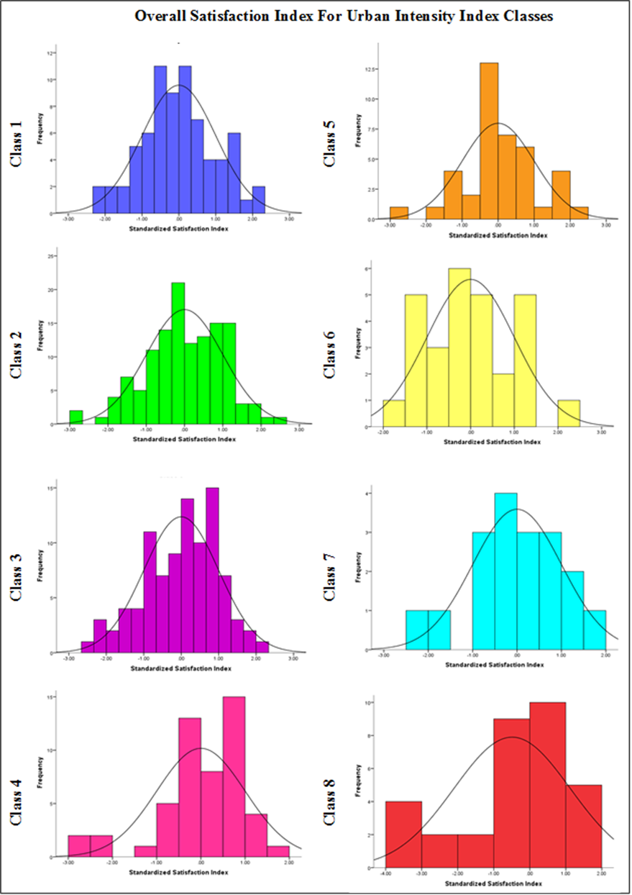
Index Probability Profiles

Slide 60
Index Probability profiles for each UII class
Pronounced pockets of lower than expected Satisfaction were observed in higher urban intensity classes, most evident in the most urbanized class
The trends observed for the Environmental Quality Index are indicative of more concern as urbanization increases
Positive Environmental Behaviour of respondents experienced a decline within the most urban communities
No consistent trend was observed for the Freedom Index

Slide 61
Index Probability profiles for each UII class
The patterns of the Recreation and Cultural Index in classes 4 to 8 are marked by higher than expected probabilities of high access for some respondents, most striking in the most urban class
Ecosystem Disturbances, on average, appeared to have the largest impact on respondents residing in class 7 whilst the lowest and highest urban classes were the least impacted
the Total Access Index, showed a general increase with urbanization, most pronounced in class 6, before decreasing in the highest urban classes.

Slide 62
Total Access Sub – Indexes
The means and standard deviations for the Total Access sub – indexes were compared across Urban Intensity classes
Transportation, Health Care, ICT and Banking and Commerce access increase to a maximum and then fall off
Utilities, Employment, Political Representation access increase monotonically with urbanization
Education, and Safety and Protective Services show little or no trend

Slide 63
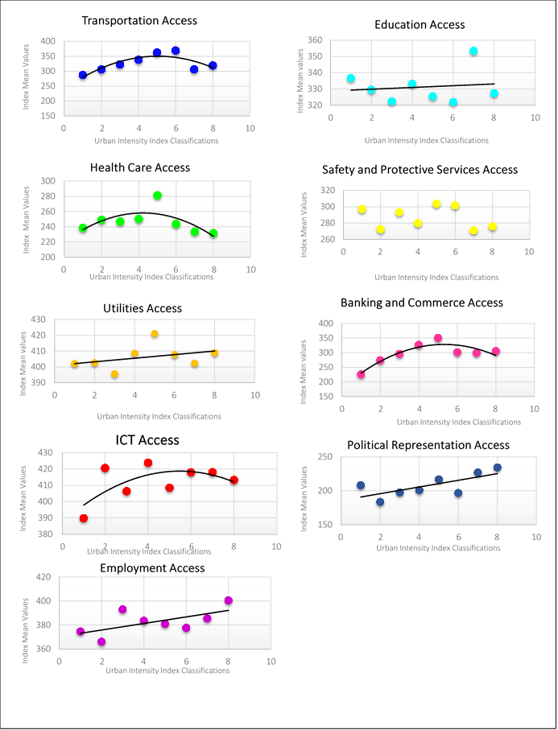
Sub – Indexes Class Means

Slide 64
Behavioural Changes in Ecosystem Services with Urbanization- Highlights
Each Index was Profiled for different Urban Intensity classes
More frequent negative z scores recorded
in the later urban intensity classes (more positive z scores for the concern of Environmental Quality and Disturbance indexes)
Recreation and Cultural Index
reflected nuances of urbanization locally
Total Access Index
to gauge how access to services, or behaviour, or satisfaction changes as urban intensity increases
Showed a general increase with urbanization
Total Access Sub – Indexes
Were examined in terms of means and standard deviations across Urban Intensity classes

Slide 65
Caveats
Respondents already had a certain level of access as the survey was administered online. (Heavy cell phone penetration)
The Community definitions by the CSO is not reflective of many binding community characteristics – established based on where the majority of persons indicated they lived
For the Urban Ecosystem Services survey, some communities had few respondents. (Survey is still running.)

Slide 66
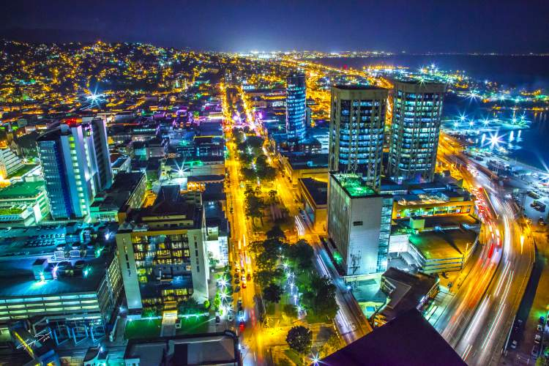
Recommendations
Advocacy for the use of the indexes as planning tools
Continue implementation of the survey at a National level – utilizing multiple modes of administration
Application of some of the indexes Regionally and Internationally
Incorporation of the Urban Intensity index classes in other local urban ecosystem studies

Slide 67
Thank You

