Slide 1


A COMPARISON OF TWO TEACHING APPROACHES AT TERTIARY EDUCATION INSTITUTIONS IN TRINIDAD AND TOBAGO: A MULTIPLE METHODS INVESTIGATION
PhD Thesis Defense Presentation
Candidate: Ms. Rhonda D. Dookwah
Supervisor: Professor V. Stoute
Date: Thursday 23rd July, 2015

Slide 2
Overview
Introduction
  Need for Innovation in Teaching
  Problem Statement
  Research Objectives
Literature Review
  TCI and PBL
  Recent Innovations in Teaching
Methodology
  Design
  Interventions
  Limitations?

Slide 3
Overview
Data Analysis
  Thematic Analysis – Journal entries, Focus groups
  Quantitative Data Analysis – Structured surveys, Performance scores
Results
  Microeconomics
  Macroeconomics
  Developmental Mathematics
Conclusions
Recommendations

Slide 4
Introduction

Slide 5
Dearth of Research on Teaching Approaches at Tertiary Education in Trinidad
Calls from Prominent Educators to equip students with content knowledge and critical thinking skills
Research Objectives
Constructivism: Shifted Emphasis from Teacher-centered to Student-Centered Instruction
Prominent Education Reports Call for Restructuring of Learning Processes (UNESCO, 2000)

Slide 6
PROBLEM STATEMENT
Can Problem-Based Learning provide an innovative Teaching Approach, comparable to Teacher-Centered Instruction, for subjects at the Tertiary level?
.

Slide 7
RESEARCH OBJECTIVES
For each of the three different subject areas, to estimate quantitatively (using performance scores in a repeated measures design) the significance of the performance impact of each of the Teacher-Centered Instruction (TCI) and Problem-based Learning (PBL) intervention approaches. (Main Effects)
For each of the three different subject areas, to estimate quantitatively, using two model approaches, the significance of any differences in performance impact between the TCI and PBL approaches. (Interaction Effect)
Notes:
This problem statement is accompanied by three research objectives. Objectives were used in the study and not research questions because both the question and the approach used to deliver a solution are imbedded in each aligned objective.

Slide 8
RESEARCH OBJECTIVES
3. To estimate quantitatively, using two statistical models with combined subject performance scores, the significance of any subject impact on relative effectiveness of the two (TCI and PBL) approaches. (3-way Interaction Effect)
4. For each of the three different subject domains, to summarize and compare qualitative and quantitative information on the themes of student perceptions of the PBL and TCI interventions

Slide 9
WHAT ARE THE TARGETS OF PERFORMANCE TESTS DATA?
MAIN EFFECTS
(PBL_{post}- PBL_{PRE}) and (TCI_{post}- TCI_{PRE})
INTERACTION EFFECT
(PBL_{post}- PBL_{PRE}) - (TCI_{post}- TCI_{PRE})
SUBJECT EFFECT
[(PBL_{post}- PBL_{PRE}) - (TCI_{post}- TCI_{PRE}) ]_{MICRO} versus [(PBL_{post}- PBL_{PRE}) - (TCI_{post}- TCI_{PRE}) ]_{MACRO} versus [(PBL_{post}- PBL_{PRE}) - (TCI_{post}- TCI_{PRE}) ]_{DEV.MATH.}
NOT INTERESTED IN (PBL_{PRE}- TCI_{PRE}) OR
(PBL_{POST} - TCI_{POST})

Slide 10
LITERATURE REVIEW

Slide 11
LEARNING THEORIES:
Behaviorism to Constructivism
Behaviorism
  Reinforced behavior is repeated
Cognitivism – Creation of mental constructs
Social Cognitivism- Bandura’s modeling theory
Constructivism
  Cognitive constructivism – Active student involvement to create knowledge
  Social Constructivism – Lev Vygotsky – Importance of the more knowledgeable student in groups.
  (Eggen & Kauchak, 2013; Schweitzer & Stephenson, 2008)
Notes:
Behaviorism – Classical (Pavlov – Strengthen association between stimulus and responses) or operant conditioning (Skinnner – Reinforced behavior is repeated)

Slide 12
Teacher - Centered Instruction - 20th Century Approach
The traditional instruction of which the teacher is the centre of the learning process (Expository Model).
He / She holds the knowledge and does the majority of the verbalization about content.
Teaches the entire class simultaneously.
Students listen and take notes
  (Snow, 2003; Valentino, 2007).

Slide 13
INNOVATIONS - Straddling 20th and 21st century teaching- Student centered approaches
Problem-based Learning (PBL):
  Characterized by the use of ill-structured, complex, real-world problems as a context in which self-directed students learn through facilitated problem solving in small groups (Boud, 2003; Hmelo-Silver, 2004).
  PBL in this study uses the Maastricht’s seven- stage process (Boud & Feletti, 2003).
The Flipped Classroom - A 21st Century Teaching Approach- an innovation beyond PBL – the classroom is moved to the home
The Flat Classroom – A 21st century suggested approach which argues that continents and societies can be spanned in one classroom without walls.

Slide 14
Linking 20th to 21st Century Teaching
Attributes | PBL | Flipped Classrooms
Role of Teacher | Teacher is facilitator – “guide on the side” Provides reinforcement and clarification when needed | Teacher is facilitator. Teacher provides higher order learning activities at school to compliment the home learning experience.
Role of student | Active engagement | Students are provided with thought provoking videos at home that can spur classroom discussions and activities for the next class session. Active engagement
Method | Starts with a problem that has authentic use and multiple forms of solutions. | Class lectures are recorded and watched at home while the teacher assists students with homework in school.

Slide 15
LINKING 20th and 21st Century Teaching
Criteria | PBL | Flipped Classrooms
Time of preparing projects | Teacher prepares modules before class; considered time consuming, generally. | Teacher prepares modules before class; considered time consuming initially.
Higher order thinking skills | Exposes students to content which allows them to learn and understand content at Bloom’s highest level. Provides for deep inquiry. | Exposes students to content which allows them to learn and understand content at Bloom’s highest level. Provides for deep inquiry.
Experiences | Authentic experiences | Students are guided by pre-recorded sessions on videos.

Slide 16
Methodology-
Ethical Issues

Slide 17
Institutional approval
Participants’ approval
Approval to use a survey (Loyens)
Voluntary participation in Journaling Experiments, Focus groups, and Structured Surveys
Confidentiality of information
Anonymity of information, where needed.
Notes:
All approvals and ethical issues were observed.

Slide 18
Methodology-
Experimental Design

Slide 19
Criteria | Microeconomics | Macroeconomics | Developmental Mathematics
Population | Third year students (B.Ed.) | Third year students (B.Ed.) | First year Assoc. Deg.
 | Pre-formed groups | Pre-formed groups | 48 students who got less than 50% in a Diagnostic test were assigned to groups.
Samples | Two groups: PBL- 16 students and TCI- 16 students for a total of 32 students | Two groups: PBL- 16 students and TCI- 10 students for a total of 26 students | Two groups: PBL 24 students and TCI 24 students for a total of 48 students

Slide 20
Criteria | Microeconomics |  | Macroeconomics |  | Developmental Mathematics
DATA COLLECT INSTRUM. | Pre- and Post- Performance tests Journal entries |  | Pre- and Post- Performance tests Post-intervention survey Focus Groups Discussions |  | Pre- and Post- Performance tests Pre- intervention survey (A) Post-intervention surveys B & C Focus Groups Discussions
INTERV | TCI | PBL | TCI | PBL | TCI | PBL
 | 12 SESSIONS |  | 12 SESSIONS |  | 15 SESSIONS
 | 12 LECT | 4 MOD | 12 LECT | 4 MOD | 15 LECT | 5 MOD
Notes:
Intervention

Slide 21
PHASE | PBL | TCI
PRE-TEST | First session
INTERV 12 to 15 Weeks | Micro- and Macroeconomics: 4 modules Mathematics: 5 modules | ALL Lectures
 | (Modules - 3 sessions per module) Session 1: Students receive module with ill defined problem; assign tasks to each member. Session 2: Explore resources to find solutions, discuss materials with teacher and colleagues, self study. Session 3: Discuss solutions in groups, share solutions of problems with the class. | One Lecture Per Session
POST-TEST | Final Session
Same Researcher for all subjects in both TCI and PBL

Slide 22
Methodology-
Data
Analysis

Slide 23
Analysis of Qualitative Information
Student Journal Entries
  Collected during and at the end of the course
  Thematic Analysis and Summaries,
  Excerpts of actual illustrative statements
Focus groups
  Semi-structured approach – Discussion was conducted under pre-chosen themes, although allowed to flow and roam into new areas
  New areas captured as new themes
  Frequency of themes noted
  Previous literature studies with the same sentiments noted

Slide 24
Statistical Analysis of Structured Surveys
Data Summary- Loyens and Proprietary Surveys
  Frequency Distributions- Demographics -Both
  Frequency Distributions- Perceptions- Loyens
  Means- Agreement with scale item- Proprietary (P)
  (larger mean nearer to 5)
  Standard deviations- Consensus among respondents (P)
  (small std. dev.)
Reliability Analysis – Proprietary Surveys
  Alpha value for entire scale ( > 0.70)
  Alpha value if item removed (increase or decrease)
Exploratory Factor Analysis – Proprietary Surveys
  Extraction of Multivariate latent themes
  Variance Explained by Factor Solution
  Used as variates in t and ANOVA tests of demographics

Slide 25
Statistical Analysis of Structured Surveys
Correlation Analysis
  Chi Squared test of independence for demographics and intervention type versus categorical outcomes- Loyens ALONE
  Pearson Product Moment Correlation of pairs of factors from different scales- Proprietary ALONE
t and ANOVA with demographic grouping variables
  t (sex, employment), ANOVA (age, education, ...)
  Dependent variable – factor scores
t tests – for TCI/PBL
  Dependent variable- Scale item manifest scores
  Done for every item on every scale in post survey

Slide 26
Quantitative Data Analysis- Performance Data
The pre- and post-intervention test scores were analyzed using
The Linear Mixed and the General Linear Models (SPSS V.22)
The PBL versus TCI is a fixed independent factor
Subject is a fixed independent factor
The time of test (pre- or post intervention) is a repeated factor.
Performance Test scores (whether pre- or post-intervention test) form the values of the dependent variable.

Slide 27
Results-
Microeconomics

Slide 28
Sample Demographics-Microeconomics
Gender: TCI: Predominantly female (87.5%)
PBL: Predominantly female (87.5%)
Age: Majority was 20-25 years old (62.5%)
Status: Mostly single (62.5%)
Education: O’levels (100%)
        O’level Economics (56.88%)
        A’levels (23%)
        A’level Economics (23%)

Slide 29
Journal Entries (TCI)- Excerpts
Major Themes | Description of actual students’ entries | Observed in
Teacher dependence (13) | My success in this subject seemed to depend on the teacher rather than me. I depended on the teacher for good explanations of all topics. I did not feel I had to read because the explanation was good. | Qi (2011), Brackenbury (2012), Gratton et al (2009)
More group work (11) | I think more group work would have helped me to understand Microeconomics.
Focused learning (16) | I knew exactly what to focus on for my lectures and assignments.
Boredom (12) | I was bored by the repetition of explanations the teacher had to do to help other students, who did not read.
Apprehen-sion (13) | I feel I have to do too much for my examination. I am not confident I can read and understand ‘Micro’ in time to do my exam good.

Slide 30
Journal Entries (PBL)-Excerpts
Major Themes | Journal Entries | Observed
Student responsibility for learning (autonomy, self motivation, self directed, and independent learner)- (16) | The more I read, the more I understood the material. This is an important step to helping students become self-directed learners. In PBL students learn to be self-directed, independent and interdependent learners motivated to solve a problem. | Ertmer et al. (2014) Mane et al. (2012)
Development of lifelong skills – (16) learning to learn) | I learnt how to learn with PBL. | Hmelo-Silver (2012)
Time consuming (12) | The PBL approach encouraged me to do my own research, so I took longer to do my school work in order to understand it. | Mane et al. ((2012)

Slide 31
Estimates of Fixed Effects - Microeconomics
Parameter | Estimate (Scores) | Std. Error | df | t | Sig. | 95% C.I
 |  |  |  |  |  | Lower | Upper
INTERCEPT | 85.1 | 1.8 | 30 | 45.7 | .000 | 81.3 | 88.9
[Pedagogy=.00] (TCI-Post test ) | -24.0 | 2.6 | 30 | -9.1 | .000 | -29.4 | -18.6
[Pedagogy=1.00] (PBL) | 0 | 0 | . | . | . | . | .
[Type=.00] (-Pre-Test , PBL) | -81.5 | 2.2 | 48 | -37.7 | .000 | -85.8 | -77.2
[Type=1.00] (Post-test ) | 0 | 0 | . | . | . | . | .
[Type=.00] * [Pedagogy=.00] | 26.0 | 3.1 | 48. | 8.5 | .000 | 19.9 | 32.4
Dependent Variable: Performance Test Score. Intercept PBL Post-test Interaction effect – comparison of effectiveness ( GAP) for PBL and TCI

Slide 32
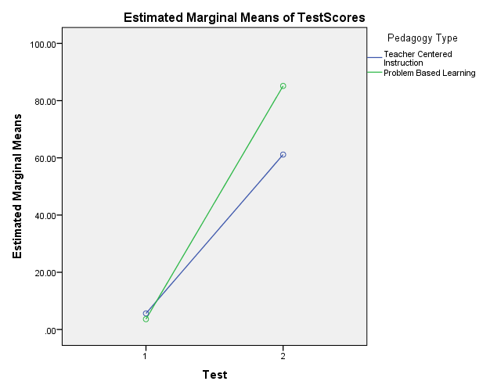
Estimated Marginal Means of Test Scores
The PBL Pre- and Post- Performance Gap is bigger than that for TCI

Slide 33
Results-
Macroeconomics

Slide 34
Sample Demographics-Macroeconomics
Gender: TCI: Predominantly female (90%)
PBL: Predominantly female (81.25%)
Age: Majority was 21-25 years old (54%)
Status: Mostly single (77%)
Education:
        O’levels (100%)
        O’level Economics (27%)
        A’levels (15%)
        A’level Economics (15%)

Slide 35
Focus Groups Sentiments
Themes | TCI Sentiments | PBL Sentiments
General Impressions of the Intervention | Want more involvement Like it Focused Allows us to finish the syllabus | Caused me to think Allows for independent and group thinking at the same time It causes students to engage in self-learning It was a different learning experience. I was motivated to do the work Encouraged me to be responsible for my learning
Strengths of the Intervention | Focused, orderly, one-to-one interaction Appealed to my learning style Motivated me Method is fair | Good understanding of content More involved in the learning of work Encouraged good group collaboration Able to do the exam better Received a lot of feedback Research was part of our activities

Slide 36
Focus Groups Sentiments
Themes | TCI Sentiments | PBL Sentiments
Limitations | Does not cater for individual differences Macroeconomics is hard, so I needed more than board instructions No collaboration Boring Lacks self expression | Time consuming May not be suitable for hard subjects like Macroeconomics PBL is not as orderly as TCI
Perceived Students’ Role | Sit and take notes Listen Read on your own Regurgitate for exams Ask the teacher questions to solve problems | More individualized and group learning Leadership role is increased PBL encourages persons to assist each other

Slide 37
Focus Groups Sentiments
Themes | TCI Sentiments | PBL Sentiments
TCI Versus PBL | N.A. | Deeper understanding Use of technology in PBL Encouraged collaboration more than TCI Social Loafing in group work PBL leads to a better understanding PBL demands group work, unlike TCI

Slide 38
Post-Intervention Survey (% Frequency)
 | KNOWLEDGE CONSTRUCTION | S.A
1 | Relate new subject matter to previously acquired knowledge | 89
2 | Previous learned facts are the building blocks of new knowledge | 85
3 | When studying new material, helpful to use previous learning experiences. | 85
4 | Instructors stimulate students to actively process the subject matter. | 85
5 | Learning is relating new information to your existing knowledge | 81
6 | Subject matter can be optimally remembered when you repeat in own words what you have read. | 73
7 | Students need to be actively engaged in their learning process, otherwise no effective learning can take place | 69
8 | Previously learned knowledge hardly plays a role when learning new knowledge. | 23
9 | Relating different study topics with each other is not necessary, because course tests deal with predefined parts of the subject matter. | 12

Slide 39
Post-Intervention Survey (% Frequency)
 | COOPERATIVE LEARNING SCALE | S.A.
1 | Discussing subject matter with fellow-students leads to a better understanding. | 89
2 | By working together with fellow-students, I can master the subject matter more easily. | 77
3 | I can learn a lot from my fellow-students | 73
4 | I like working together with fellow-students. | 46
5 | Studying alone yields more benefit than studying with fellow-students. | 35
6 | Studying is something you do on your own. | 35
7 | Mastering subject matter is an individual activity. | 31
8 | Since course tests are administered individually, there is little use in working together with fellow-students | 23
9 | Working together with fellow-students in small groups is less efficient compared to attending lectures. | 12

Slide 40
Post-Intervention Survey (% Frequency)
 | SELF-REGULATION | S.A
1 | The topics to be studied need to be defined by the teacher. | 77
2 | Preparing for a test is difficult when the teacher has not pointed out exactly what has to be studied | 73
3 | Teachers need to indicate what students need to know about a study topic and what not. | 69
4 | If subject matter is difficult, you should better ask the teacher for explanation instead of sifting it out yourself. | 62
6 | It is too time consuming when students have to explore the subject matter by themselves, it is more efficient to instruct. | 23
7 | Selecting and exploring subject matter is not efficient. You better focus on the articles and book chapters that the teacher has indicated. | 23
8 | When a student does not grasp specific subject matter, the teacher should not explain it, but encourage the student to find it out on their own. | 15
9 | Enabling students to make their own selection of the subject matter, leads to deficiencies in their knowledge and abilities. | 8

Slide 41
Post-Intervention Survey (% Frequency)
 | PRACTICAL LEARNING EXPERIENCE | S.A
1 | Knowledge is primarily useful when it can be applied (e.g., in your future job). | 100
2 | Above all, acquired knowledge has to be useful for practice situations. | 96
3 | You learn the most when assignments in class strongly resemble activities and tasks of the professional life. | 85
4 | Emphasis on practical abilities during the curriculum gives you a head start in your future job. | 85
5 | A good way of studying is to ask yourself how you can use knowledge in the future (e.g., in your job). | 81
6 | The most important topics in your program are topics that are useful for practice (e.g., in your future job). | 62
7 | If the knowledge you learned is not applicable (e.g., in a job, in daily life), you did not learn much. | 39

Slide 42
Post-Intervention Survey (% Frequency)
 | SELF- PERCEIVED ABILITY TO LEARN | S.A.
1 | I am confident I will finish this programme | 81
2 | I usually feel confident for a test, because I did what I could to prepare myself in the best possible way. | 58
3 | I can easily distinguish main and side issues. | 58
4 | I could use some help with my study. | 42
5 | Being enrolled in university classes is difficult, because you don't know exactly what you need to study. | 27
6 | I often find myself lost in details | 19
7 | Sometimes I think I am not intelligent enough to understand the subject matter. | 15
8 | I often feel uncertain about what I have to study | 15
9 | Selecting literature for a class by myself makes me feel uncertain. | 15
10 | I doubt if I can complete this study successfully. | 8
11 | I think I will have a hard time finishing my course. | 8
12 | I often feel helpless with respect to my studies. | 4

Slide 43
Post-Intervention Survey ( % Frequency)
 | SELF-MOTIVATION FOR LEARNING | S.A
1 | I don’t spend sufficient time on studying. | 42
2 | I seldom feel like studying | 31
3 | I do not have a clear study approach | 27
4 | I easily find the motivation | 23
5 | The majority of the subject matter to be studied is not interesting in my opinion. | 23
6 | I preferably postpone my study activities until the very last moment | 19
7 | I like being engrossed in my books. | 12
8 | I like studying | 8

Slide 44
Post-Intervention Survey-Demographics Chi Square
DEMO | Correlated Variable | Phi, V | p | TREND
SEX Male /Female | Subject matter can be optimally remembered when you repeat in own words what you have read. | 0.696 | 0.002 | Strongly Agreed: Women (81%), Men (25%)
 | Most important topics in your program are useful for practice ( future job). | 0.513 | 0.033 | Strongly Agreed: Women (68%), Men (25%)
 | I seldom feel like studying. | 0.518 | 0.030 | Strongly Disagreed: Women (5%), Men (50%)
AGE 21 - 25 years /26-30 years | You learn more effectively if you try to relate subject matter with previously learned knowledge. | 0.468 | 0.040 | Strongly Agreed: Younger people (21 -25) – 100% , Older (26-30)- 64% .
 | I like being engrossed in my books | 0.608, 0.430 | 0.048 | Strongly Disagreed: Younger people ( 21 -25) – 14% , Older (26-30)- 27%
Notes:
Chi-Square analysis showed the test of independence between demographics and the scaled items.

Slide 45
Post-Intervention Survey-Demographics Chi Square
Demo | Correlated Variable | Phi , V | p | Trend
MARITAL STATUS Single /Married | Previously learned knowledge has no role in learning | 0.513 | 0.033 | Strongly Agreed : Married (0%), Single (30%).
 | I preferably to postpone my study activities until the very last moment | 0.531 | 0.026 | Strongly Disagreed :Married (50%), Single (5%)
HIGHEST EDUC. LEVEL CSEC or ‘O’ level/No CXC passes in Econ/ /CAPE or ‘A’ level | Relating different study topics with each other is typically a task of the teacher. | 0.658, 0.465 | 0.024 | Strongly Agreed: CAPE or ‘A’ level passes (100%), CSEC or ‘O’ (18%), no CXC in Econ (19%).
 | Too time consuming for students to explore subject matter themselves. | 0.717, 0.507 | 0.010 | Strongly Agreed: CAPE or ‘A’ level passes (75%), CSEC or ‘O’ (34%), no CXC in Econ (6%).
 | I could use some help with my study | 0.626, 0.443 | 0.037 | Strongly Agreed: CAPE or ‘A’ level passes (100%), CSEC or ‘O’ (0%), no CXC Econ(44%).

Slide 46
Post-Intervention Survey- PBL/TCI Chi Square
Correlated Variable | Phi & V | p | Trend (students)
Previous learned facts are the building blocks of new knowledge. | 0.54 | 0.006 | Strongly agreed : PBL (100%); TCI (60%)
Previously learned knowledge hardly plays a role when learning new knowledge. | 0.64 | 0.005 | Strongly disagreed : PBL(63%) TCI (0%)
Since course tests are administered individually, there is little use in working together with fellow students | 0.71 | 0.001 | Strongly agreed - PBL (0%), TCI (60%)
Teachers need to indicate what students need to know about a study topic and what not. | 0.52 | 0.030 | Strongly agreed - PBL(56%), TCI (96%)

Slide 47
Post-Intervention Survey- PBL/TCI Chi Square
Correlated Variable | Phi & V | p | Trend
If subject matter is difficult, you should better ask the teacher for explanation instead of sifting it out yourself | 0.50 | 0.038 | Strongly agreed - PBL(44%), TCI (90%)
Selecting and exploring subject matter is not efficient. You better focus on the articles and book chapters that the teacher has indicated. | 0.55 | 0.019 | Strongly agreed - PBL(6%), TCI (50%)
I preferably postpone my study activities until the very last moment | 0.54 | 0.021 | Strong disagreement - PBL (0%), TCI (40%)

Slide 48
Estimates of Fixed Effects - Macroeconomics
Parameter | Estimate (Scores) | Std. Error | df | t | Sig. | 95% C. I.
 |  |  |  |  |  | L | U
INTERCEPT | 87.6 | 2.2 | 24.0 | 39.5 | .000 | 83.1 | 92.2
[Pedagogy=.00] , (TCI, Post-test ) | -13.2 | 3.6 | 24.0 | -3.7 | .001 | -20.6 | -5.9
[Pedagogy=1.00] (PBL) | 0 | 0 | - | - | - | - | -
[Type=.00] (-Pre-Test, PBL) | -84.6 | 2.9 | 46.2 | -29.6 | .000 | -90.4 | -78.9
[Type=1.00] (Post-test) | 0 | 0 | - | - | - | - | -
[Type=.00] * [Pedagogy=.00] | 21.2 | 4.6 | 46.2 | 4.6 | .000 | 11.9 | 30.5
Dependent Variable: Test Score. Intercept = PBL Post—test Interaction effect = GAP of GAPS

Slide 49
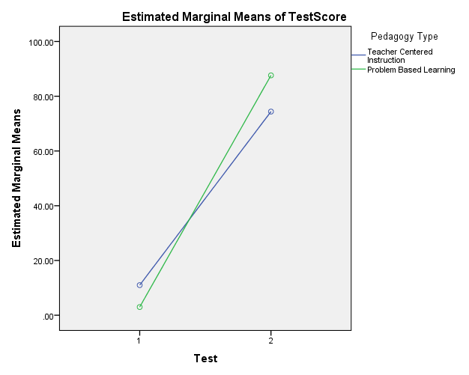
Pre- and Post- Intervention Mean Test Scores
In the Pre-test the TCI group had the higher mean above the PBL, whereas in the Post-test, the PBL group had the higher mean score. The interaction effect is significant.

Slide 50
Results - Developmental Mathematics

Slide 51
Sample Demographics-Mathematics
Gender: Predominantly female (60%)
Age: Majority 25-35 years old (67%)
Status: Mostly single (75%)
Education: Majority had at least some secondary education (92%)
Employment: Almost all employed (96%)
  currently employed in the government service (58%) or
  private industry (31%)
Prior work experience
  mainly in private industry ( 67%) and/or
  in the government service (58%).

Slide 52
Focus Groups Sentiments
Themes | Sentiments | N.
 |  | TCI | PBL
Approach to teaching | Enjoyment Showed students how to learn Forced to read Liked problems Self-directed learning Do not mind this way of teaching | 18 00 08 00 02 12 | 24 16 19 21 24 15
Social Relationships | Developed leadership roles Liked group work Learnt to listen to peers Learnt from group members Developed respect for others’ opinions Allowed me to share resources with my peers Learnt to interact with peers | 00 05 01 11 05 00 03 | 18 22 22 22 20 22 24
Resources | Depended on teacher Would have preferred more time to read Did not like the textbook, did not understand it | 21 15 11 | 20 18 03

Slide 53
Focus Groups Sentiments
Themes | Sentiments | N.
 |  | TCI | PBL
Pace of Teaching | Liked the pace Deeper understanding of material Monotonous learning experiences | 11 00 23 | 24 21 00
Emotional Intelligence | Assisted me in developing confidence in doing Mathematics Motivated me to do Mathematics Experiences made me want to continue with the programme | 02 08 06 | 20 21 21
Role of the Teacher | Enjoyed positive feedback from the teacher Resourceful Too fast in teaching for me to understand Makes learning easy Very supportive | 00 00 13 07 10 | 24 24 - 23 24
Notes:
What is surprising is how much the PBL students commented positively on the role of the teacher. This is especially counterintuitive because PBL is the intervention which is presumed to be more independent of the teacher.

Slide 54
Focus Groups Sentiments
PBL |  | TCI
Advantages | Limitations | Advantages | Limitations
Learn how to learn | Social Loafing | Focused | Competitive
Encourages uses of resources | Time consuming | Familiar with the process, so keep it. | Want more involvement
Learn to listen to peers | Unstructured | Fair method | Monotonous learning style
Motivating | Not suitable for ‘hard’ subjects | Motivating | Regurgitation of course content
Learnt more in groups |  |  | Limited understanding
Adds to students’ confidence |  |  | Boredom

Slide 55
Focus Groups Sentiments
PBL |  | TCI
Advantages | Limitations | Advantages | Limitations
Leadership roles are developed
Independent learning
Subject specific interest
Autonomy
Deeper understanding of content
Increased social skills
More positive themes were generated by the PBL students than by the TCI participants.

Slide 56
Summaries of Scaled Items
Pre-Intervention Data (N=48)
REASONS FOR JOINING THE PROGRAMME | Mean | Std. Dev.
To improve my practical skills in order to earn a better job | 4.98 | 0.14
To improve my knowledge in order to get a better job | 4.90 | 0.31
To gain promotion in my current job | 3.40 | 2.02
I was encouraged to do so by a family member/spouse | 1.65 | 1.97
Personal satisfaction | 1.42 | 1.88
Larger mean, more agreement among respondents;
smaller std. dev. more consensus among respondents.
Notes:
On entry to the course, students stated that the most important reason for joining the programme was because they wanted to improve their practical skills in order to earn a better job.
Note personal satisfaction was rated very low, with very little agreement among participants.

Slide 57
Pre-Intervention Survey Data (N=48)
KNOWLEDGE CONSTRUCTION AND COOPERATIVE LEARNING | Mean | Std. Dev.
Studying alone yields more benefit than studying with fellow students | 4.04 | 1.54
Working together with fellow-students in small groups is less efficient compared to attending lectures. | 3.88 | 1.71
Discussing subject matter with fellow-students leads to a better understanding | 1.35 | 1.59
When working in a group, team members respect me as a participant | 1.23 | 1.54
I can learn a lot from my fellow students | 1.04 | 1.53

Slide 58
Pre-Intervention Survey Data (N=48)
SELF-REGULATION | Mean | Std. Dev.
If subject matter is difficult, you should ask the teacher for an explanation instead of working it out yourself | 4.63 | 0.89
Linking different study topics with each other is typically a task of the teacher | 4.40 | 1.27
It is too time consuming when students have to explore the subject matter by themselves. It is more efficient to instruct. | 4.04 | 1.67
When a student does not grasp specific subject matter, the teacher should not explain it, but should encourage the student to find it out on his/her own. | 0.83 | 1.29

Slide 59
Pre-Intervention Survey Data (N=48)
AUTHENTIC PROBLEMS | Mean | Std. Dev.
Emphasis on practical abilities during the course gives you a head start in your future job. | 1.94 | 1.54
You learn most when assignments in class strongly resemble activities and tasks of the professional life. | 1.88 | 1.63
The most important topics in your program are useful for practice in a future job. | 1.85 | 1.61
A good way to study is to ask yourself how you can use knowledge in the future in your job. | 1.42 | 1.46

Slide 60
Pre-Intervention Survey Data (N=48)
SELF-PERCEIVED ABILITY TO LEARN | Mean | Std. Dev.
I could use some help with my study. | 4.40 | 0.82
Selecting literature for a class by myself makes me feel uncertain. | 4.38 | 1.06
I often feel uncertain about what I have to study. | 4.00 | 1.27
I usually feel confident for a test, because I did what I could to prepare myself in the best possible way. | 1.56 | 1.41
I am confident I will finish this programme. | 1.56 | 1.61

Slide 61
Pre-Intervention Survey Data (N=48)
MOTIVATION TO STUDY | Mean | Std. Dev.
I do not have a clear study approach. | 4.15 | 1.17
I do not spend sufficient time on my studies. | 3.83 | 1.24
I often find myself lost in details | 3.81 | 1.32
I preferably postpone my study activities until the very last moment. | 3.67 | 1.36
I like being engrossed in my books. | 1.94 | 1.49
I easily find motivation to study | 1.79 | 1.52
I can easily distinguish main and side issues | 1.56 | 1.46

Slide 62
Post-Intervention Survey data (N=24,24)
REASONS FOR JOINING THE PROGRAMME | TCI | PBL | COMB | Pre
To improve my practical skills in order to earn a better job | 4.46 | 4.96 | 4.44 | 4.98
To improve my knowledge in order to get a better job | 3.92 | 4.42 | 4.19 | 4.90
Personal satisfaction | 3.42 | 4.96 | 4.19 | 1.42
To gain promotion in my current job | 2.38 | 4.38 | 3.38 | 3.40
I was encouraged to do so by a family member/spouse | 2.08 | 2.46 | 2.27 | 1.65

Slide 63
Post-Intervention Survey data (N= 24,24)
UNDERSTANDING TOPICS IN COURSE | TCI | PBL
The operation of Subtraction | 5.00 | 5.00
The operation of Addition | 5.00 | 4.96
Notation and numeration up to millions. | 4.25 | 4.86
Percentages | 4.08 | 4.42
Fractions | 3.96 | 4.71
The operation of Division | 3.76 | 3.67
Graphs | 3.71 | 3.80
Proportions | 3.71 | 4.63
Ratios | 3.67 | 4.17
The operation of Multiplication | 3.58 | 4.96
Decimals | 3.30 | 4.80
Linear Equations | 3.13 | 3.83
Algebra | 3.04 | 3.75

Slide 64
Post-Intervention Survey data (N= 24,24)
IMPORTANCE OF FEATURES OF TCI APPROACH | TCI | PBL
Using the textbook as a resource in class | 4.50 | 2.42
Being able to complete at home exercises not completed in class | 4.50 | 4.83
Practicing exercises in class | 4.33 | 4.42
Having the lecturer correct questions on topics in class | 4.08 | 3.88
The Lecturer’s use of the board to explain and pass on content information to all students | 3.92 | 0.80
Having one lecture on a topic per day | 3.92 | 0.33
Having a personal interest in passing the course | 3.88 | 4.80
Being in a competitive learning environment | 3.75 | 0.92
Having traditional assessment such as a class test | 2.75 | 0.87
Having a formal atmosphere in class | 2.67 | 0.63

Slide 65
Post-Intervention Survey data (N= 24,24)
IMPORTANCE OF FEATURES OF THE PBL APPROACH | TCI | PBL
Having lecturer’s and class feedback through discussions on each group’s presentations on modules in class. | 4.13 | 4.96
Having the class pace determined by the rate at which students completed each module | 4.13 | 4.92
Having alternative assignments, e.g. oral presentations | 4.08 | 4.92
Having resources used throughout sessions, e.g. online resources in class. | 3.42 | 4.88
Participating in collaborative learning | 4.42 | 4.83
Having an informal atmosphere | 3.42 | 4.80
Having the class start with problems in modules for groups of students to solve. | 5.00 | 4.67
Having content practice in groups | 4.43 | 4.38

Slide 66
Post-Intervention Survey data (N= 24,24)
ATTITUDES TOWARDS LEARNING | TCI | PBL
Willingness to seek help from others (teacher, other students) when working on mathematics problems. | 4.25 | 4.42
Enthusiasm for the subject | 4.13 | 4.96
Developing my resourcefulness in searching for relevant information on mathematics topics, e.g. online, other mathematics books. | 3.67 | 4.67
Recommending this mathematics course to your colleagues. | 3.58 | 4.80
Planning to take additional courses in mathematics. | 3.54 | 3.17
Remembering mathematics skills for a long time. | 3.42 | 4.75
Applying what I learnt in this class in other situations such as on my job, or everyday activities, e.g. calculating VAT for an item. | 3.25 | 3.42
Enjoying learning mathematics. | 3.21 | 4.88
Discussing mathematics with friends or family. | 2.08 | 2.42
Confidence that you can do mathematics. | 0.92 | 4.67

Slide 67
Factor Solution Goodness of Fit for Scales
Post-Intervention Survey
Scale | KMO (samp. adeq.) | % Variance Explained
Reasons for Joining | 0.50 | 55%
Effectiveness of Instructional Approach | No solution | Some scale items had zero variance
Traditional Teaching | 0.79 | 57%
Alternative Teaching | 0.66 | 79%
Instructional Approach Impact on Attitudes | 0.50 | 65%
Anti Image Correlation off diagonal elements small and diagonal elements from about 0.6 to 0.8 in most cases, Bartlett’s test of sphericity significant

Slide 68
Cronbach Alpha Values for Scales
Post-Intervention Survey
Scale | Alpha | Alpha value if item deleted
Reasons for Joining | --- | List of items
Effectiveness of Instructional Approach | ---- | List of items
Traditional Teaching | 0.741 | ‘Having a personal interest’ (α =0.787)
Alternative Teaching | 0.748 | ‘Having the class start with problems in modules for students to solve’ (α = 0.792). ‘Having content practice in groups’ (α = 0.772).
Instructional Approach Impact on Attitudes | 0.663 | ‘Discussing mathematics with friends or family’ (α =0.729).

Slide 69
Significant and Non-Significant t-tests (PBL/TCI)
Pedagogical Elements | Total Items | Significant ‘t’ test | Non- Sig. ‘t’ test
Reasons for Joining Programme | 5 | 3 | 2
Knowledge Construction | 6 | 6 | 0
Cooperative Learning | 5 | 2 | 3
Self- Regulation | 5 | 0 | 5
Authentic Problems | 4 | 4 | 0
Self-perceived ability to learn | 7 | 2 | 5
Motivation | 6 | 3 | 3
Total | 38 ITEMS | 20 ITEMS | 18 ITEMS
Note- no ‘omnibus’ decision- Bonferroni adjustment not applicable

Slide 70
Impact of Demographics on Scale Factors- t, ANOVA
Sex has no impact on perceptions for this sample.
When marital status is coalesced into single and ‘other’, this also results in no significant difference for any scale factor scores (themes).
The effect of employment (yes/no) could not be explored because, although only two categories, almost 96% of the individuals in the sample were employed.
Education can be coalesced into those with full secondary or tertiary versus those with primary or partial secondary. When tested this way, education had no effect on the perceptions of this sample.
Age could not be tested since the largest age group is the 25 to 35 years old category (67%). Could not coalesce older and younger age groups as one group. Conceptually wrong for a hierarchical variable.

Slide 71
Estimates of Fixed Effects-Developmental Mathematics
Parameter | Estimate (Scores) | Std. Error | df | t | Sig. | 95% C.I
 |  |  |  |  |  | L | U
INTERCEPT | 90.1 | 2.8 | 46 | 32.8 | .000 | 84.6 | 95.7
[Pedagogy=.00] (TCI, Post-test ) | -25.0 | 3.9 | 46 | -6.4 | .000 | -32.7 | -17.1
[Pedagogy=1.00] (PBL) | 0 | 0 | . | . | . | . | .
[Type=.00] (-Pre-Test , PBL) | -67.2 | 3.6 | 90.4 | -18.4 | .000 | -74.5 | -60.0
[Type=1.00] (Post-test ) | 0 | 0 | . | . | . | . | .
[Type=.00] * [Pedagogy=.00] | 27.1 | 5.2 | 90.4 | 5.3 | .000 | 16.8 | 37.3
Dependent Variable: Test Score. Intercept = Post –test PBL Interaction Effect = GAP of GAPS

Slide 72
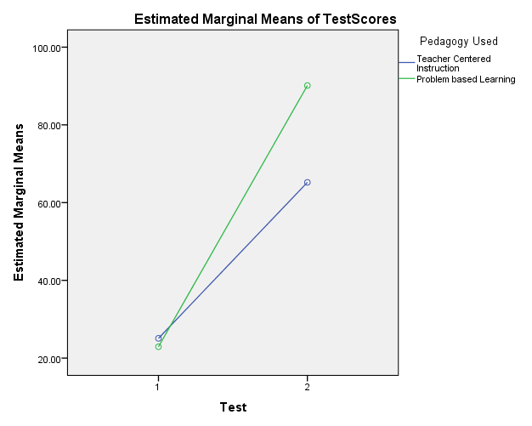
Estimated Marginal Means of Test Scores
The PBL Pre and Post- Performance Gap is bigger for PBL than the TCI

Slide 73
Results-
ALL SUBJECTS
(pooled data)

Slide 74
Impact of the TCI and PBL intervention approaches.
Subject | Pedagogy Effect (PBL-TCI) |  | Pre-test/Post-test Effect |  | Test x Pedagogy
 | Mean | Interval | Mean | Interval
Microeconomics | 11.0 | 7.8 to 14.2 | 68.5 | 65.5 to 71.6 | Significant
Macroeconomics | 2.6 | -0.9 to 6.1 | 74.0 | 69.4 to 78.7 | Significant
Developmental Mathematics | 24.9 | 17.1 to 32.7 | 53.7 | 48.5 to 58.8 | Significant
The pre- and post- intervention performance score gap is significantly different for the PBL and TCI interventions. The actual values show that for the PBL groups, that performance gap is always larger.

Slide 75
GLM 3-way Interaction for Repeated and Independent Factors
TESTS |  | Value | F | Hypo. df | Error df | Sig.
Test x Pedagogy X Subject | Pillai’s Trace | 0.009 | 0.459^{b} | 2.0 | 100.0 | 0.633
 | Wilks’ Lambda | 0.991 | 0.459^{b} | 2.0 | 100.0 | 0.633
 | Hotelling’s Trace | 0.009 | 0.459^{b} | 2.0 | 100.0 | 0.633
 | Roy’s Largest Root | 0.009 | 0.459^{b} | 2.0 | 100.0 | 0.633
All 4 multivariate tests have a p-value of 0.633 (>0.05). Tests are not significant. The subject area did not influence the relative performance impacts of the PBL and TCI interventions.

Slide 76
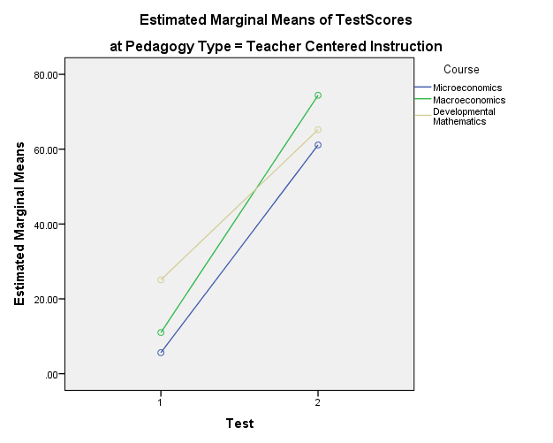
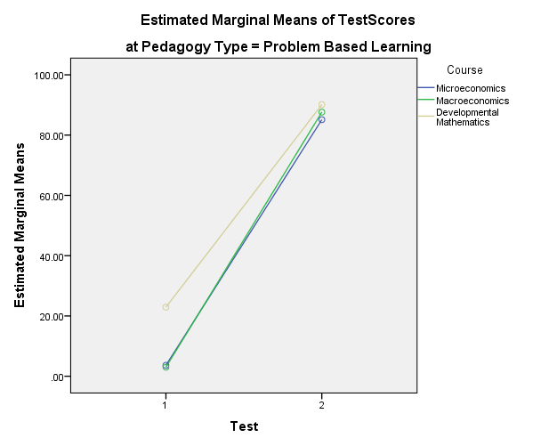
All the PBL post-intervention scores averaged more than 80, while the TCI are less than 80 – graphical illustration that the improvements due to the PBL interventions are consistently better than those due to TCI.

Slide 77
Caveats

Slide 78
Ex-Post Facto Research- Microeconomics, Macroeconomics
  Repeated Measures Design nullifies this. The target is the performance GAP not actual performance
  Change in performance GAP ( between PBL and TCI) was not significant so that for Mathematics, which was randomized, largest sample, different institution, got same result
Small Sample sizes- Macroeconomics, in particular
  Repeated Measures nullifies this
  Sample sizes standard at tertiary institutions for these subjects
Specific to type of Subjects studied
  Cannot assume that the result would be the same for language subjects, for example
Specific to institutions
  There is no reason why it should be.

Slide 79
Conclusions

Slide 80
Students’ academic performances in the Micro and Macroeconomics and Mathematics courses studied improved significantly with both the PBL and TCI interventions (significant ‘Type’ Effect).
The PBL performance GAP is significantly larger than the TCI performance GAP for each of the three subjects studied (significant ‘Type’ x ‘Pedagogy’ effect).
The difference in the degrees of improvements with the two interventions did not change significantly with the subject area (non-significant 3-way ‘Type’ X ‘Pedagogy’ x ‘Subject’ effect).

Slide 81
The PBL innovation was enjoyed by most of the students who experienced it (and even TCI students felt its elements would be interesting).
The PBL intervention…..
  motivated them,
  gave them a deeper understanding of content material,
  a better appreciation of group work,
  of researching material on their own, and
  of working independently of the instructor.

Slide 82
Recommendations

Slide 83
A judicious mix of teaching approaches (PBL and TCI) is probably optimal for use in the teaching of Microeconomics, Macroeconomics and Developmental Mathematics at the tertiary education institutions studied in this work.
Innovations in education, including more recent approaches such as the flipped and the flat classroom, should continue to be explored and the efficacy studied of including them, either in whole or in part, in teaching and learning in different subject areas.

Slide 84
REFERENCES
Bayliss, S. (2013). Flip It Now. School Library Journal, 59(11), 1.
Bergmann, J. & Sams, A. (2012). Flip your classroom: Reach every student in every class class everyday. Colorado: International Society for Technology in Education.
Bergmann, J. & Sams, A. (2013). Flipping for mastery. Educational Leadership, 71(4), 24-29.
Boud, D. (2006). Aren’t we all learner centered now? In P. Ashwin (2006). Changing higher education, the development of learning and teaching. SEDA London: Routledge.
Boud, D. & Feletti, G. I. (2003). The challenge of problem-based learning (2nd ed.). USA: Kogan Page.
Crouch, M. (2014). The Flipped Classroom. Scholastic Parent & Child, 21(5), 59.
Enfield, J. (2013). Looking at the impact of the flipped classroom model of instruction on undergraduate multimedia students at CSUN. Techtrends: Linking research & practice to improve learning, 57(6), 14-27. doi:10.1007/s11528-013-0698-1
Ferreri, S. P. & O'Connor, S. K. (2013). Redesign of a large lecture course into a small-group learning course. American Journal of Pharmaceutical Education, 77(1), 1-9.

Slide 85
REFERENCES
Flumerfelt, S. & Green, G. (2013). Using lean in the flipped classroom for at risk students. Journal of Educational Technology & Society, 16(1), 356-366.
Fulton, K. P. (2012). 10 Reasons to Flip. Phi Delta Kappan, 94(2), 20-24
Goodwin, B. & Miller, K. (2013). Evidence on flipped classrooms is still coming in. Educational Leadership, 70(6), 78-80.
Hmelo-Silver, C. E. (2004). Problem-based learning: what and how do students learn? Educational Psychology Review, 16, 235-266.
McNulty, R. (2013). Old flames and new beacons: The luminosity of online learning. Techniques: Connecting Education & Careers, 88(1), 40-43.
New, J. (2013). Fighting to Reinvent Teaching and Keep Costs Down. Chronicle Of Higher Education, 59(34), B6.
Patankar, P. (2011). Teacher Education: Need of Paradigm shift from Behaviorism to Constructivism. Indian Streams Research Journal, 1(11), 23-25.
Sams, A. & Bergmann, J. (2013). Flip your students' learning. Educational Leadership, 70(6), 16-20.
Strayer, J. F. (2012). How Learning in an Inverted Classroom Influences Cooperation, Innovation and Task Orientation. Learning Environments Research, 15(2), 171-193.

Slide 86

Thanks for your attention!
“Tell me and I forget, teach me and I may remember, involve me and I learn.”
― Benjamin Franklin

Slide 87

The End!

